Slide 1
Priority Queues

Slide 2
Priority Queue ADT
A priority queue stores a collection of entries
  Each entry is a pair (key, value)
Main methods of the Priority Queue ADT
  insert(k, x)
    inserts an entry with key k and value x
  removeMin()
    removes and returns the entry with smallest key
Additional methods
  min(): returns, but does not remove, an entry with smallest key
  size(), isEmpty()

Slide 3
Entry and Key
An entry in a priority queue is
  simply a key-value pair
Priority queues store entries to allow
  for efficient insertion and removal based on keys
A key is
  An object used
    to identify the priority of an entry of a priority queue

Slide 4
Comparator ADT
A comparator
  encapsulates the action of comparing
    two objects according to a given total order relation
  When the priority queue needs to compare two keys,
    It can uses a user-supplied comparator
The primary method of the Comparator ADT:
  compare(a, b):
    Returns an integer i such that
      i < 0 if a < b,
      i = 0 if a = b,
      i > 0 if a > b;

Slide 5
Sorting with a Priority Queue
Algorithm PriorityQueueSort(sequence S, priority Q P)
  while (!S.isEmpty( )) do
  e=S.removeFirst( );
  P.insert(e);
  while (!P.isEmpty( )) do
  e=P.remove( );
  S.insertLast(e);
Refer to TreeMapSorting Project

Slide 6
Java’s PriorityQueue Class
PriorityQueue
  orders elements by their natural ordering.
  inserts elements in priority order such that
    the highest-priority element (i.e., the largest value)
      will be the first element removed from the PriorityQueue.
Common PriorityQueue operations are
  offer
    to insert an element at the appropriate location based on priority order
  poll
    to remove the highest-priority element of the priority queue
  peek
    to get a reference to the highest-priority element of the priority queue
Refer to PriorityQueueSorting Project

Slide 7
Collection Interface and Collections Class

Slide 8
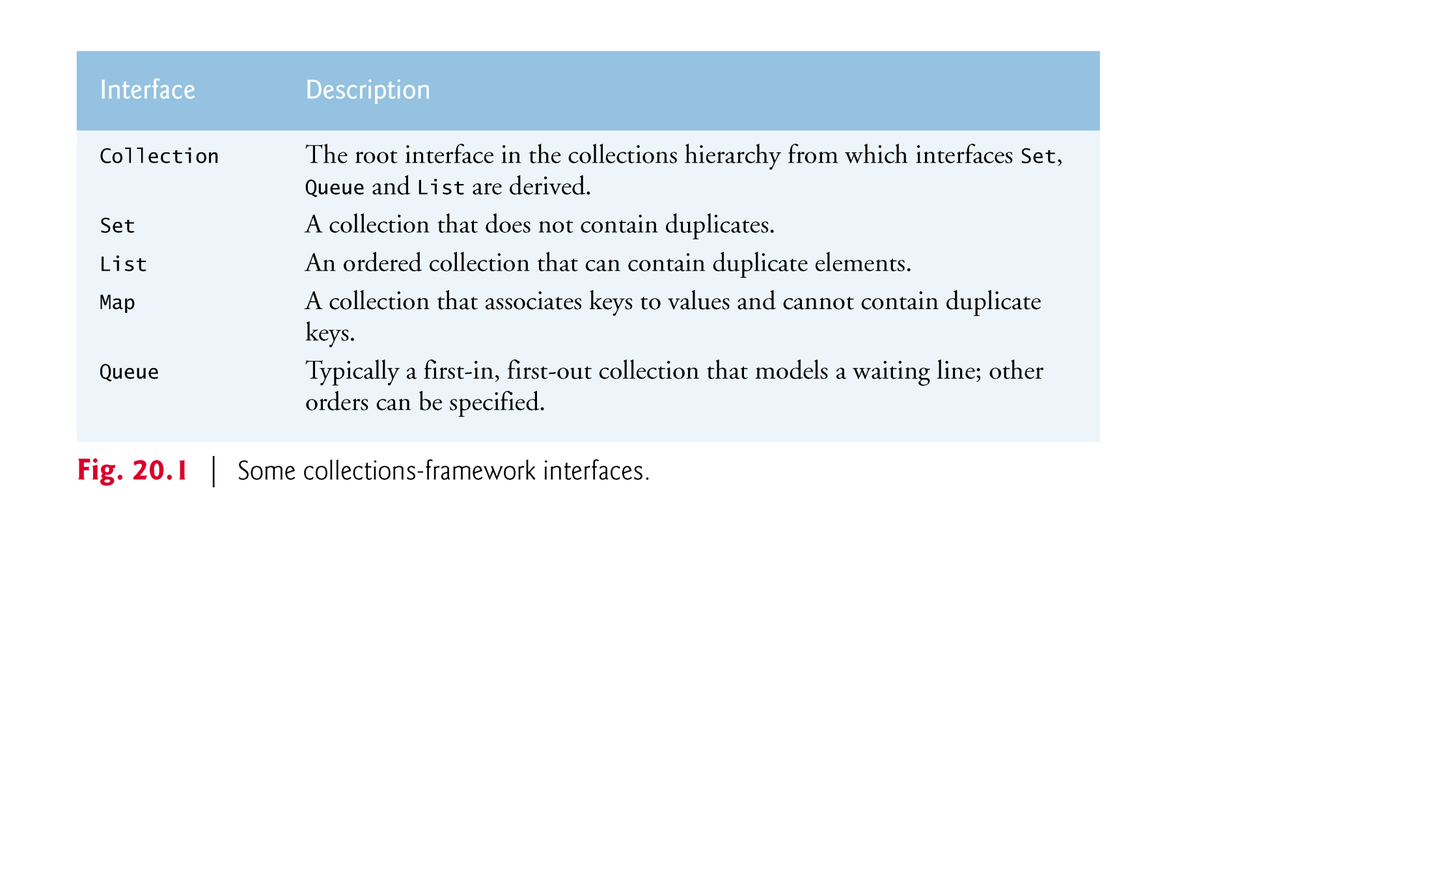
Collection interface

Slide 9
Collection interface and Collections class
Interface Collection is the root interface
  from which interfaces Set, Queue and List are derived.
Interface Set defines a
  collection that does not contain duplicates.
Interface Queue defines a
  collection that represents a waiting line.
Class Collections provides static methods
  that search, sort and perform other operations on collections.

Slide 10
Lists and LinkedList class
A List (sometimes called a sequence)
  is a Collection that can contain duplicate elements.
  is implemented by several classes,
    including ArrayList, and LinkedList.
A LinkedList enables
  efficient insertion (or removal) of elements
    in the middle of a collection.

Slide 11
LinkedList methods
addAll
  appends all elements of a collecton to the end of a List.
listIterator
  gets A List’s bidirectional iterator.
subList obtains a portion of a List.
  This is a so-called range-view method,
    which enables the program to view a portion of the list.
Refer to LinkedListApp Project

Slide 12
Arrays as Lists
Class Arrays provides static method asList
  to view an array as a List collection.
A List view allows you to manipulate
  the array as if it were a list.
This is useful for adding the elements in an array
  to a collection and for sorting array elements.
Refer to UsingToArray Project

Slide 13
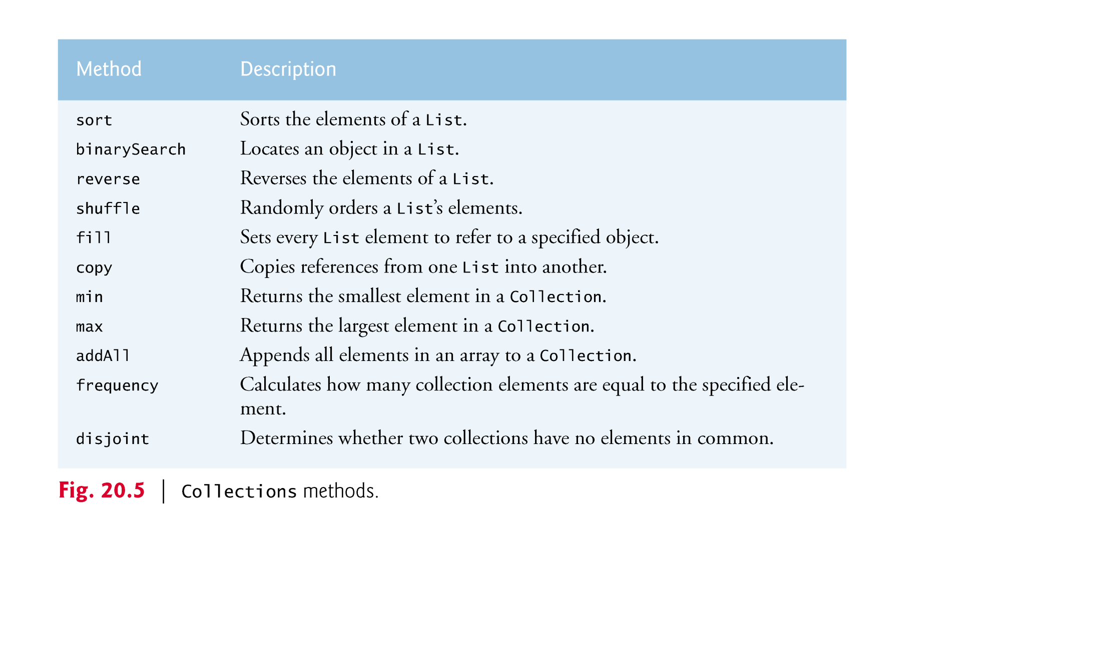
Collections Methods
Class Collections provides
  several high-performance algorithms for
    manipulating collection elements.
  Refer to UsingCollectionsMethod Project

Slide 14
Sets
A Set is an unordered Collection
  of unique elements (i.e., no duplicate elements).
The collections framework contains several
  Set implementations, including HashSet and TreeSet.
HashSet stores its elements in a hash table, and
TreeSet stores its elements in a tree.

Slide 15
Sets (Cont’d)
TreeSet method
  headSet gets a subset of the TreeSet in which every element
    is less than the specified value.
  tailSet gets a subset in which each element
    is greater than or equal to the specified value.
  first and last
    get the smallest and largest elements of the set, respectively.
Refer to RemovingDuplicates Project

