Slide 1
Generic Collections Java

Slide 2
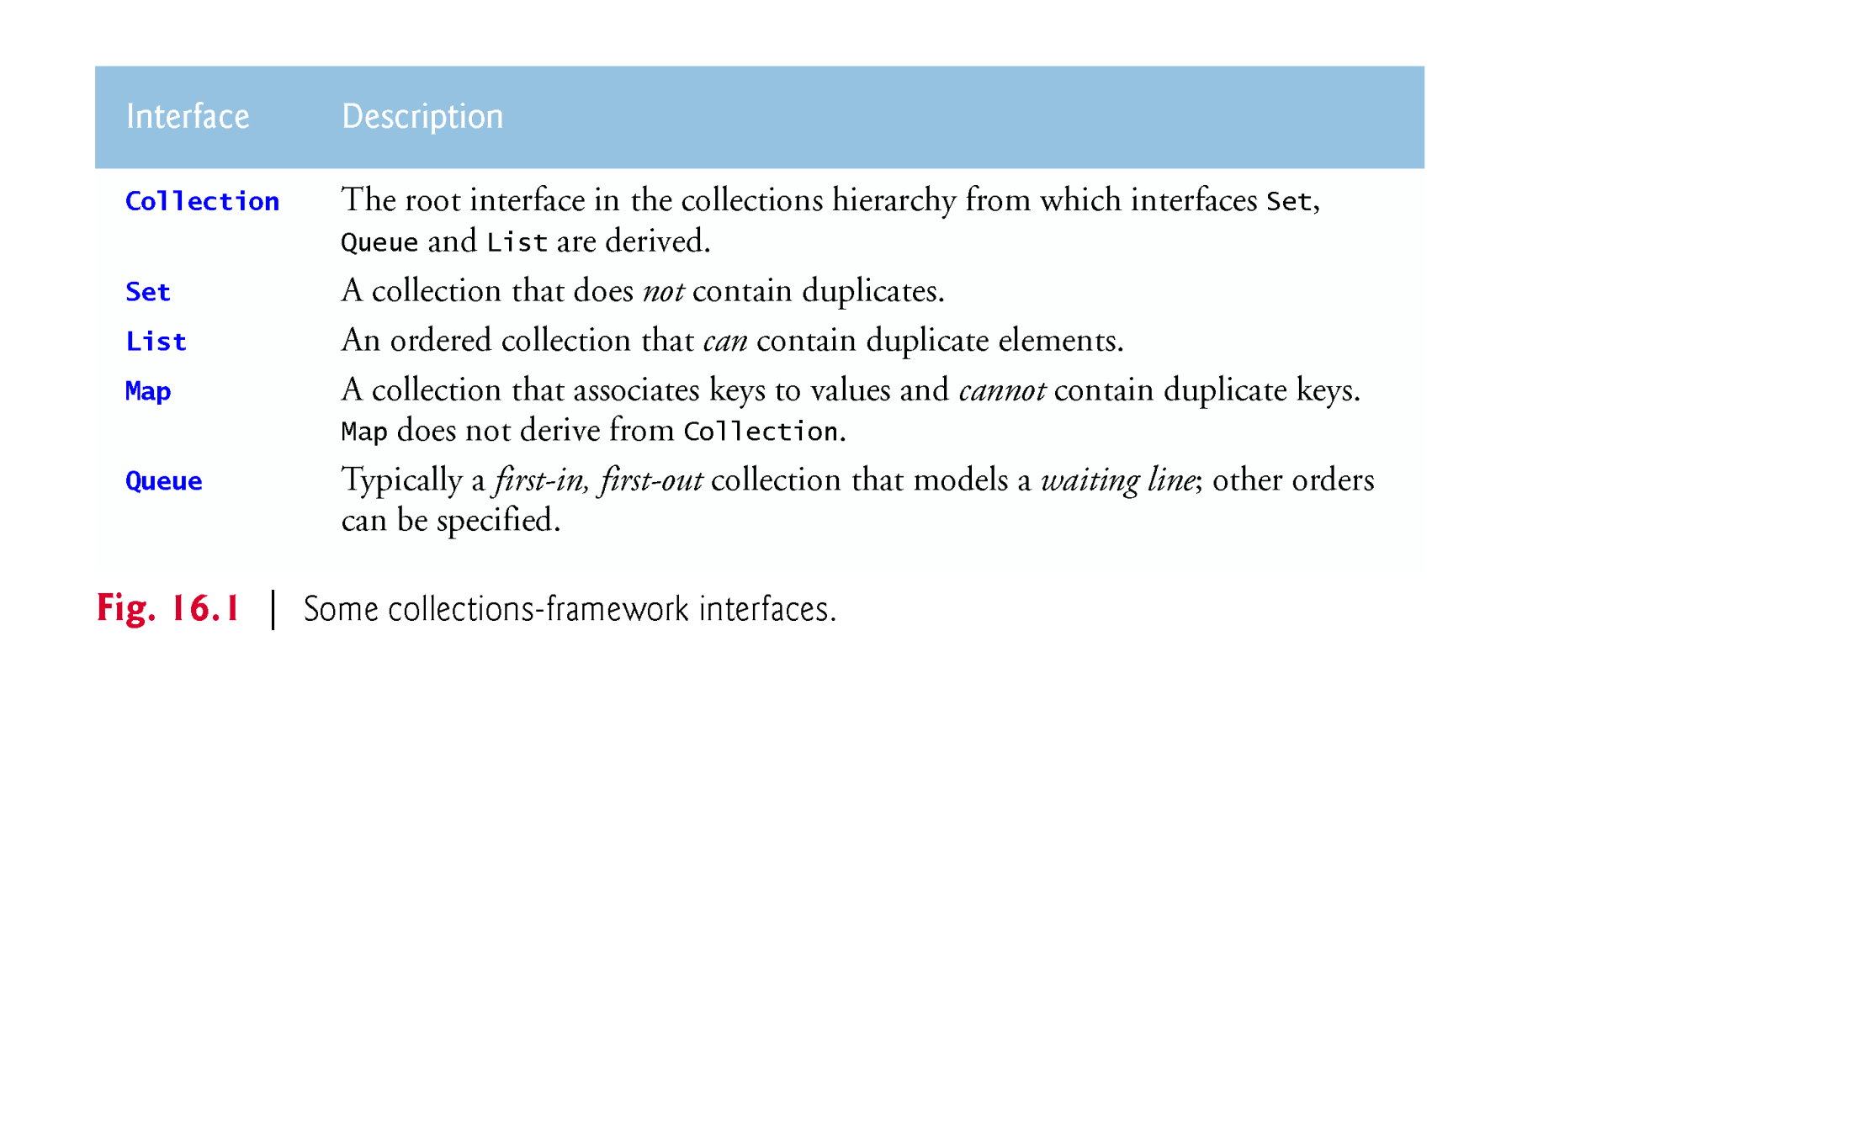
Java Collections Framework
The figure below lists some collections interfaces

Slide 3
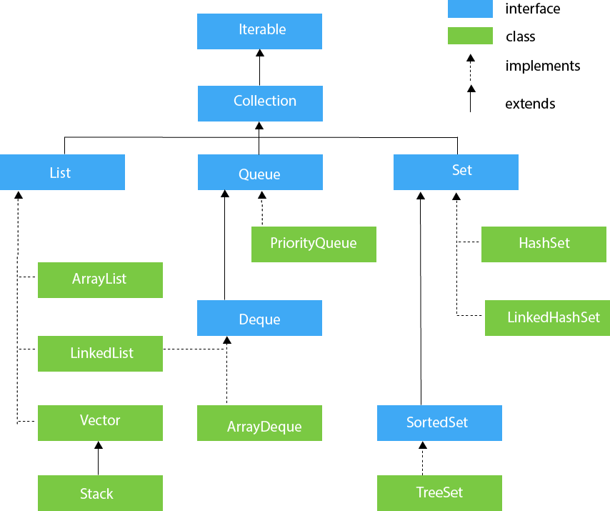
Java Collections Hierarchy

Slide 4
Difference between Collection interface and Collections class
The Collection interface
  Contains operations for
    adding and removing objects in a collection
The Collections class
  Provides high-performance static methods for manipulating
    objects created from classes implementing Collection interface

Slide 5
Lists
A List is
  a collection that can contain duplicate elements
  Implemented by several classes including
    ArrayList and LinkedList classes
A LinkedList
  Enables efficient insertion (or removal) of elements
    In middle of collection
  Is less efficient than ArrayList for jumping to a specific element in collection

Slide 6
Sets
A Set is
  a collection of unique elements
  Implemented mainly by
    HashSet and TreeSet classes
HashSet
  Stores its elements in a hash table and is not sorted
TreeSet
  Stores its elements in a tree and is sorted
  Implements SortedSet interface which is derived from Set

Slide 7
Maps
Map
  associates keys to values
    Where keys must be unique
  is implemented by
    HashMap and TreeMap
TreeMap
  maintains its keys in ascending order
  Implements the SortedMap interface
    Which is derived from the Map interface

Slide 8
Class PriorityQueue and Interface Queue
Interface Queue
  extends interface Collection
  is implemented by the PriorityQueue class
PriorityQueue
  Orders its elements by their natural order (i.e., ascending)
  Can use new ordering rules
    that are defined through the Comparator interface

Slide 9
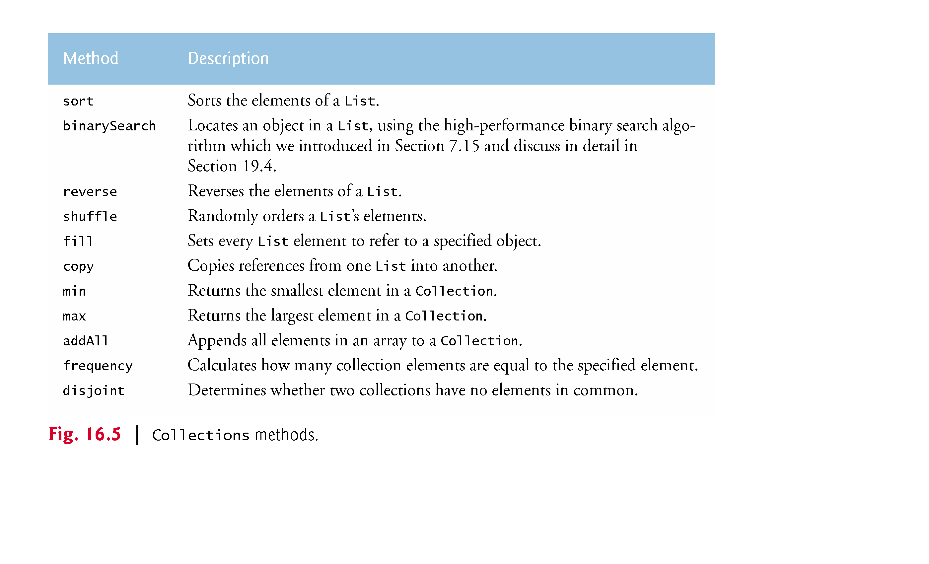
Collections class
Collections
  Provides several methods for manipulating collection elements

Slide 10
Time complexity
HashSet
  add: O(1)
  contains: O(1)
TreeSet
  add: O(log(n))
  contains: O(log(n))
PriorityQueue
  add or offer: O(log(n))
  remove or poll: O(log(n))

Slide 11
Time complexity (Continued)
ArrayList
  add: O(1)
  get(int idx): O(1)
  contains: O(n)
  remove(0): O(n)
LinkedList
  add: O(1)
  get(int idx): O(n)
  contains: O(n)
  remove(0): O(1)

Slide 12
Time complexity (Continued)
HashMap
  get: O(1)
  containsKey: O(1)
TreeMap
  get: O(log(n))
  containsKey: O(log(n))

