Slide 1
Chapter 3 Tip Calculator App
Android How to Program, 3/e

Slide 4
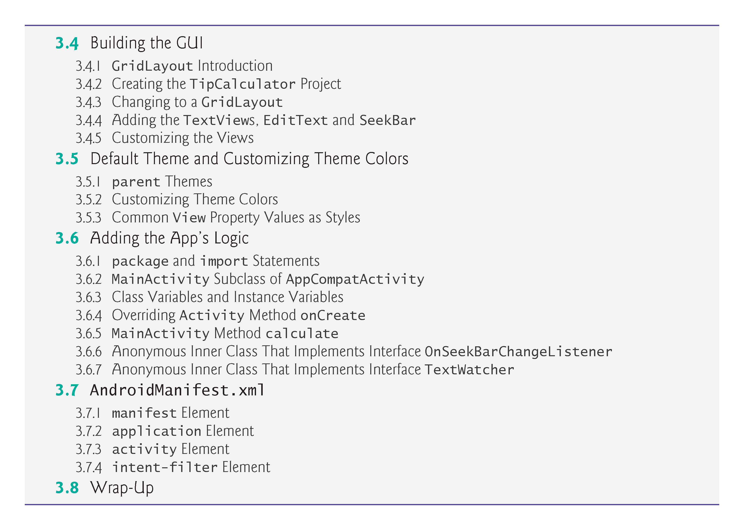

Slide 5
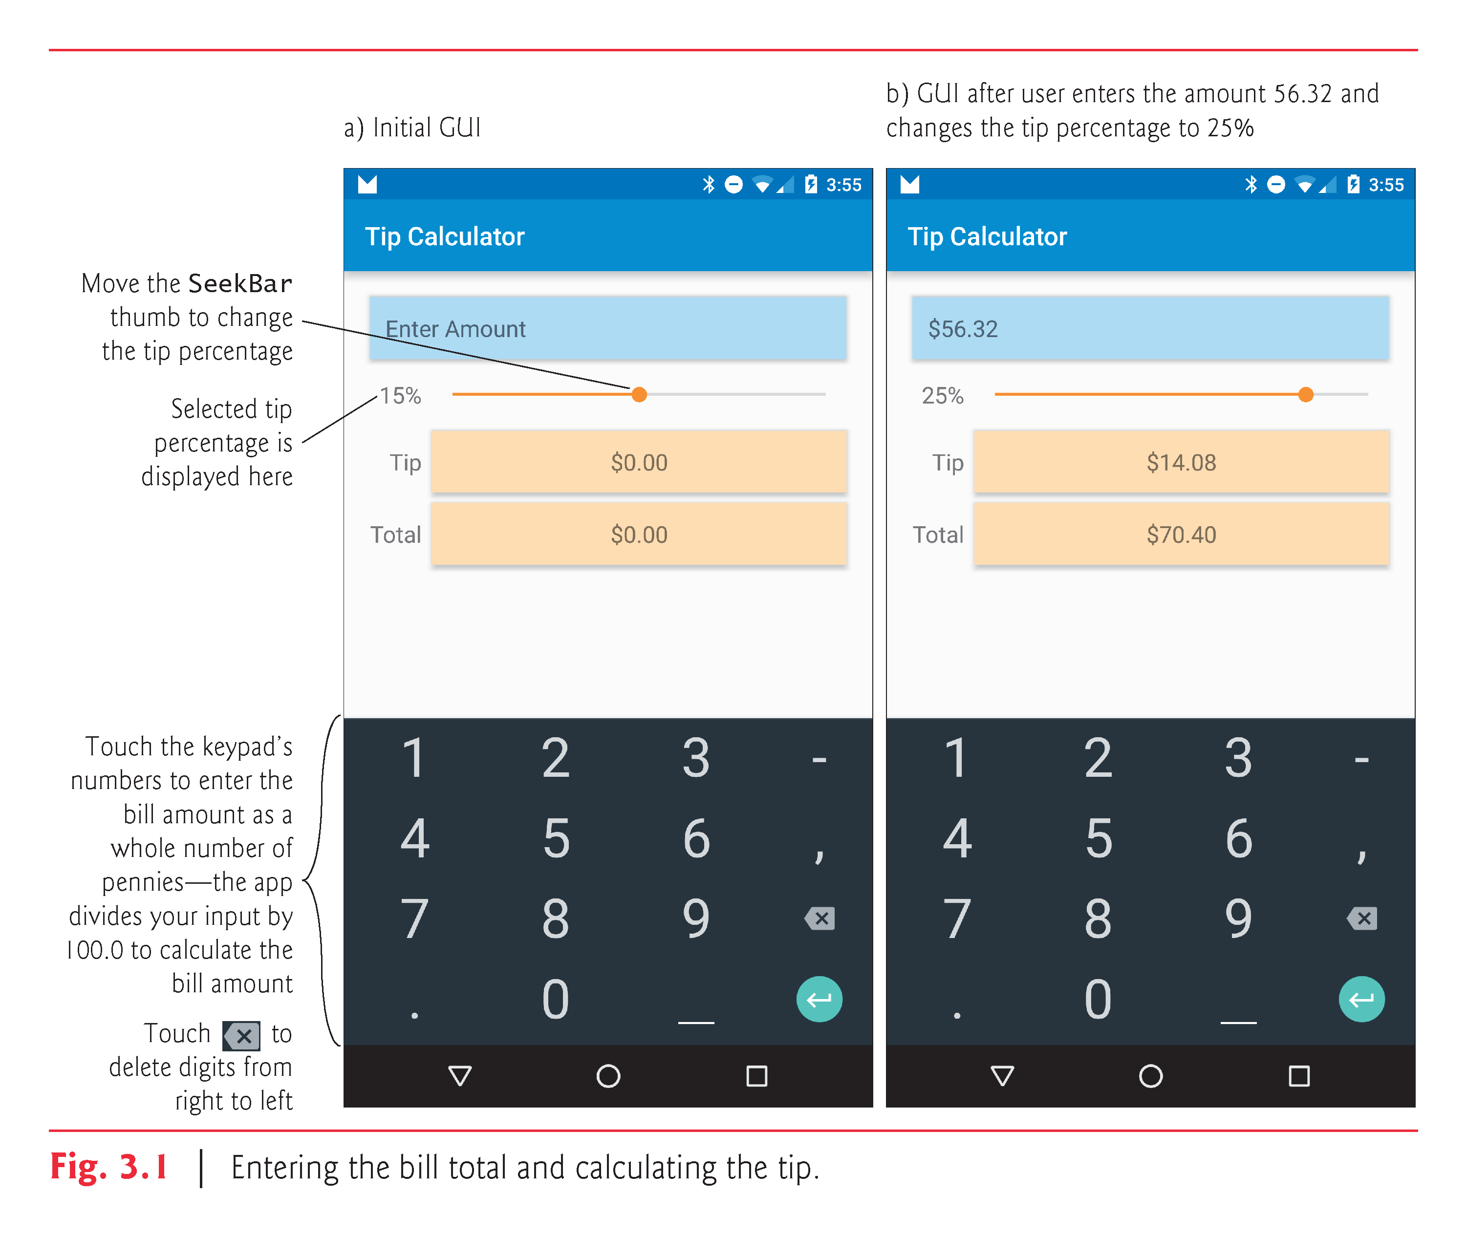

Slide 6
Tip Calculator Technologies Overview
Activities, services, content providers, broadcast receivers
Activity class (package android.app)

Slide 7
Tip Calculator Technologies Overview
Activity lifecycle
Active—visible and has focus
Paused—visible and does not have the focus
Stopped—not visible, could be killed by the OS

Slide 8
Tip Calculator Technologies Overview
Activity Lifecycle methods
onCreate—app starting, GUI about to be displayed
onStart, onPause, onRestart, onResume, onStop, onDestroy
Must call superclass versions
http://developer.android.com/reference/android/app/Activity.html

Slide 9
Tip Calculator Technologies Overview
Challenge developers face—backward compatibility
Android Support Library
Enable you to use newer Android features in apps targeting current and past Android platforms
AppCompat library
Provide an app bar (formerly the action bar) and more on devices running Android 2.1 (API 7) and higher

Slide 10
Tip Calculator Technologies Overview
Android Studio app templates use AppCompatActivity
Indirect subclass of Activity
Some Android features are not available in earlier Android versions, even if you use the AppCompat libraries
http://developer.android.com/tools/support-library

Slide 13
Tip Calculator Technologies Overview
GridLayout (package android.widget)
Android 4 (API level 14)
Android Support Library contains version for earlier platforms
Layout editor and Component Tree window
EditText (package android.widget)
SeekBar (package android.widget)
0-100 by default

Slide 14
Tip Calculator Technologies Overview
NumberFormat (package java.text)
Locale-specific currency and percentage
TextWatcher Interface (package android.text)
SeekBar.OnSeekBarChangeListener interface (package android.widget)

Slide 15
Tip Calculator Technologies Overview
NumberFormat (package java.text)
Locale-specific currency and percentage
TextWatcher Interface (package android.text)
SeekBar.OnSeekBarChangeListener interface (package android.widget)

Slide 16
Tip Calculator Technologies Overview
Theme—Look-and-feel consistent with Android
Android 5+ projects use Material Design themes
“light”—white app bar, white app background, black/dark grey text
“light” theme with a dark app bar—app bar is black with white text by default
“dark”—black app bar, dark gray app background, white/light gray text

Slide 17
Tip Calculator Technologies Overview
Theme.Material (Android 5+) and Theme.AppCompat (Android 2.1+) versions
Theme.AppCompat.Light.DarkActionBar
Apps that use the AppCompat libraries must use AppCompat themes
http://www.google.com/design/spec/style/color.html#color-themes
http://developer.android.com/training/material/theme.html

Slide 18
Tip Calculator Technologies Overview
Material design guidelines
Objects should cast shadows as in the real world
elevation property
Android automatically casts a shadow for that view
Larger values result in more pronounced shadows
Recommendations for various views
http://www.google.com/design/spec/what-is-material/elevationshadows.html

Slide 19
Tip Calculator Technologies Overview
Customize a theme’s colors (e.g., to match a company’s branding)
Material design color guidelines
primary color—with no more than three hues (shades)
accent color
http://www.google.com/design/spec/style/color.html
Primary colors—status bar, app bar
Accent color tints views—SeekBar, CheckBox, RadioButton

Slide 21
Tip Calculator Technologies Overview
Android Studio’s Theme Editor
Recommended sample color swatches
http://www.google.com/design/spec/style/color.html#color-colorpalette
Palette color recommendations
http://www.materialpalette.com/

Slide 22
Tip Calculator Technologies Overview
AndroidManifest.xml
Soft keyboard
Orientation

Slide 23
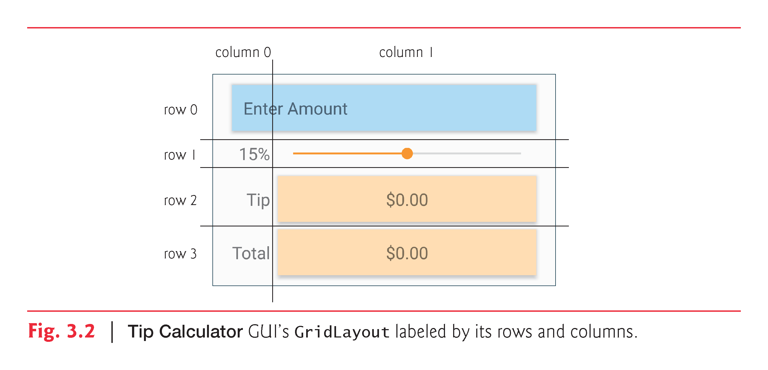

Slide 24
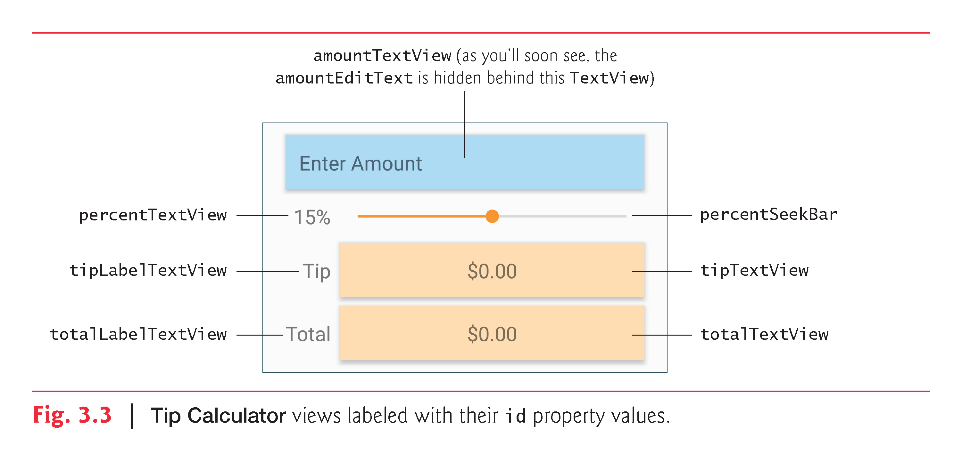

Slide 26
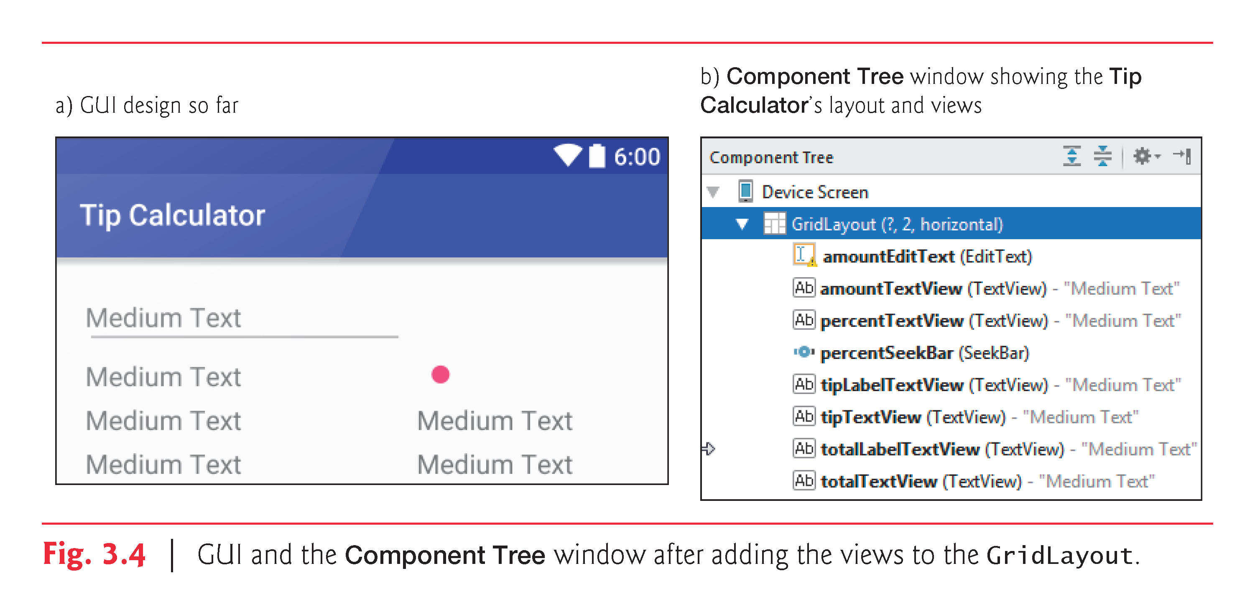

Slide 27
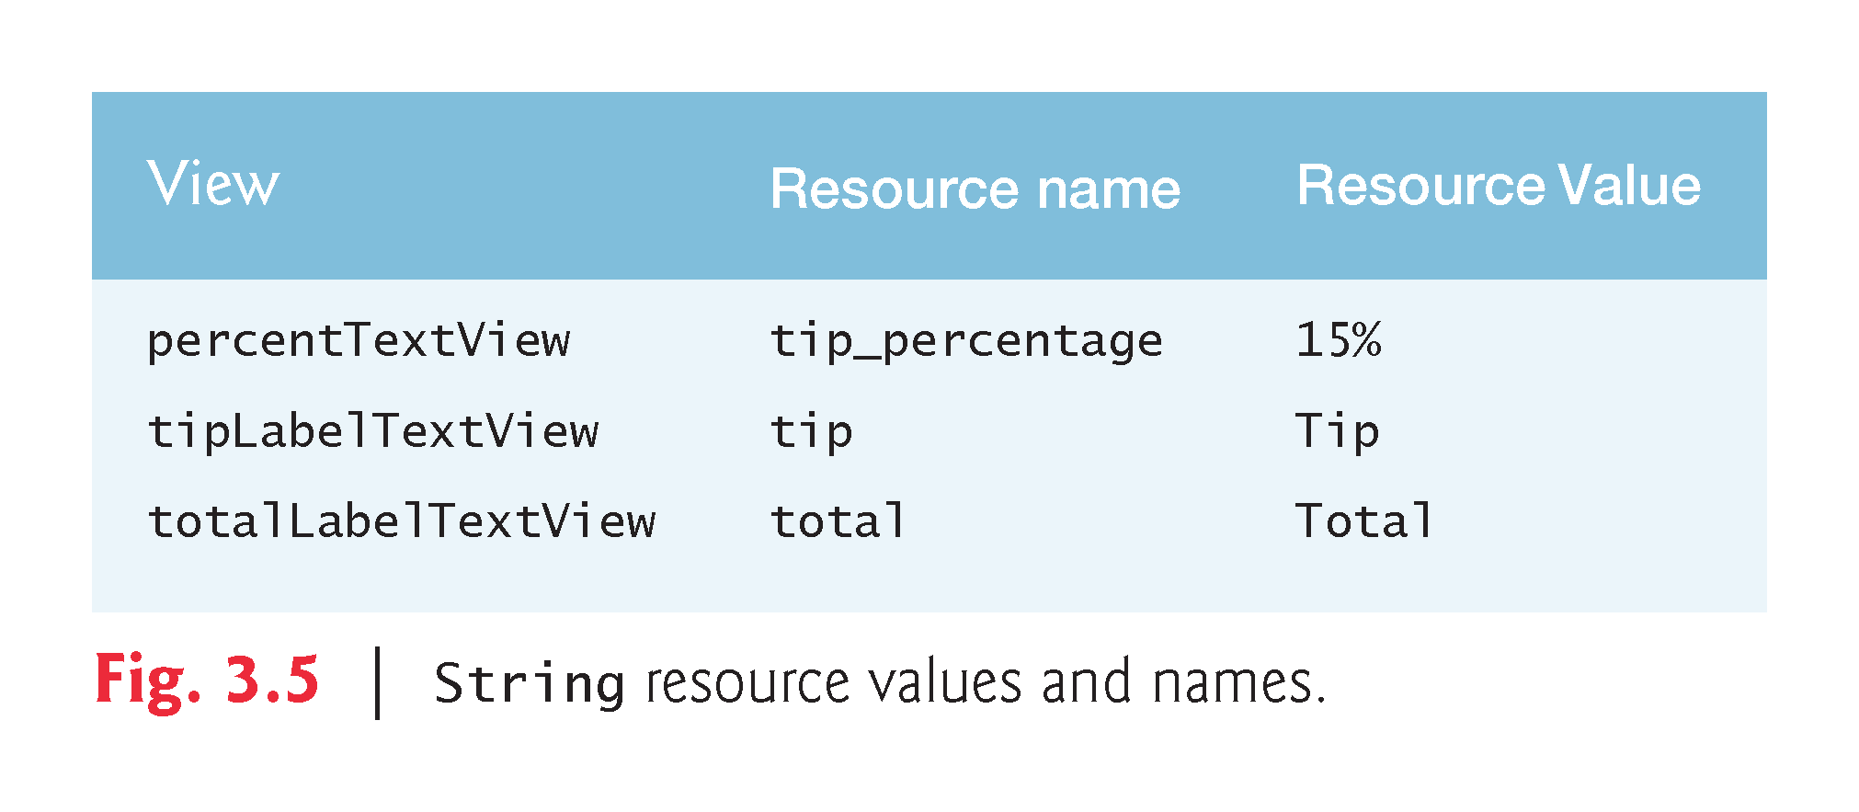

Slide 28
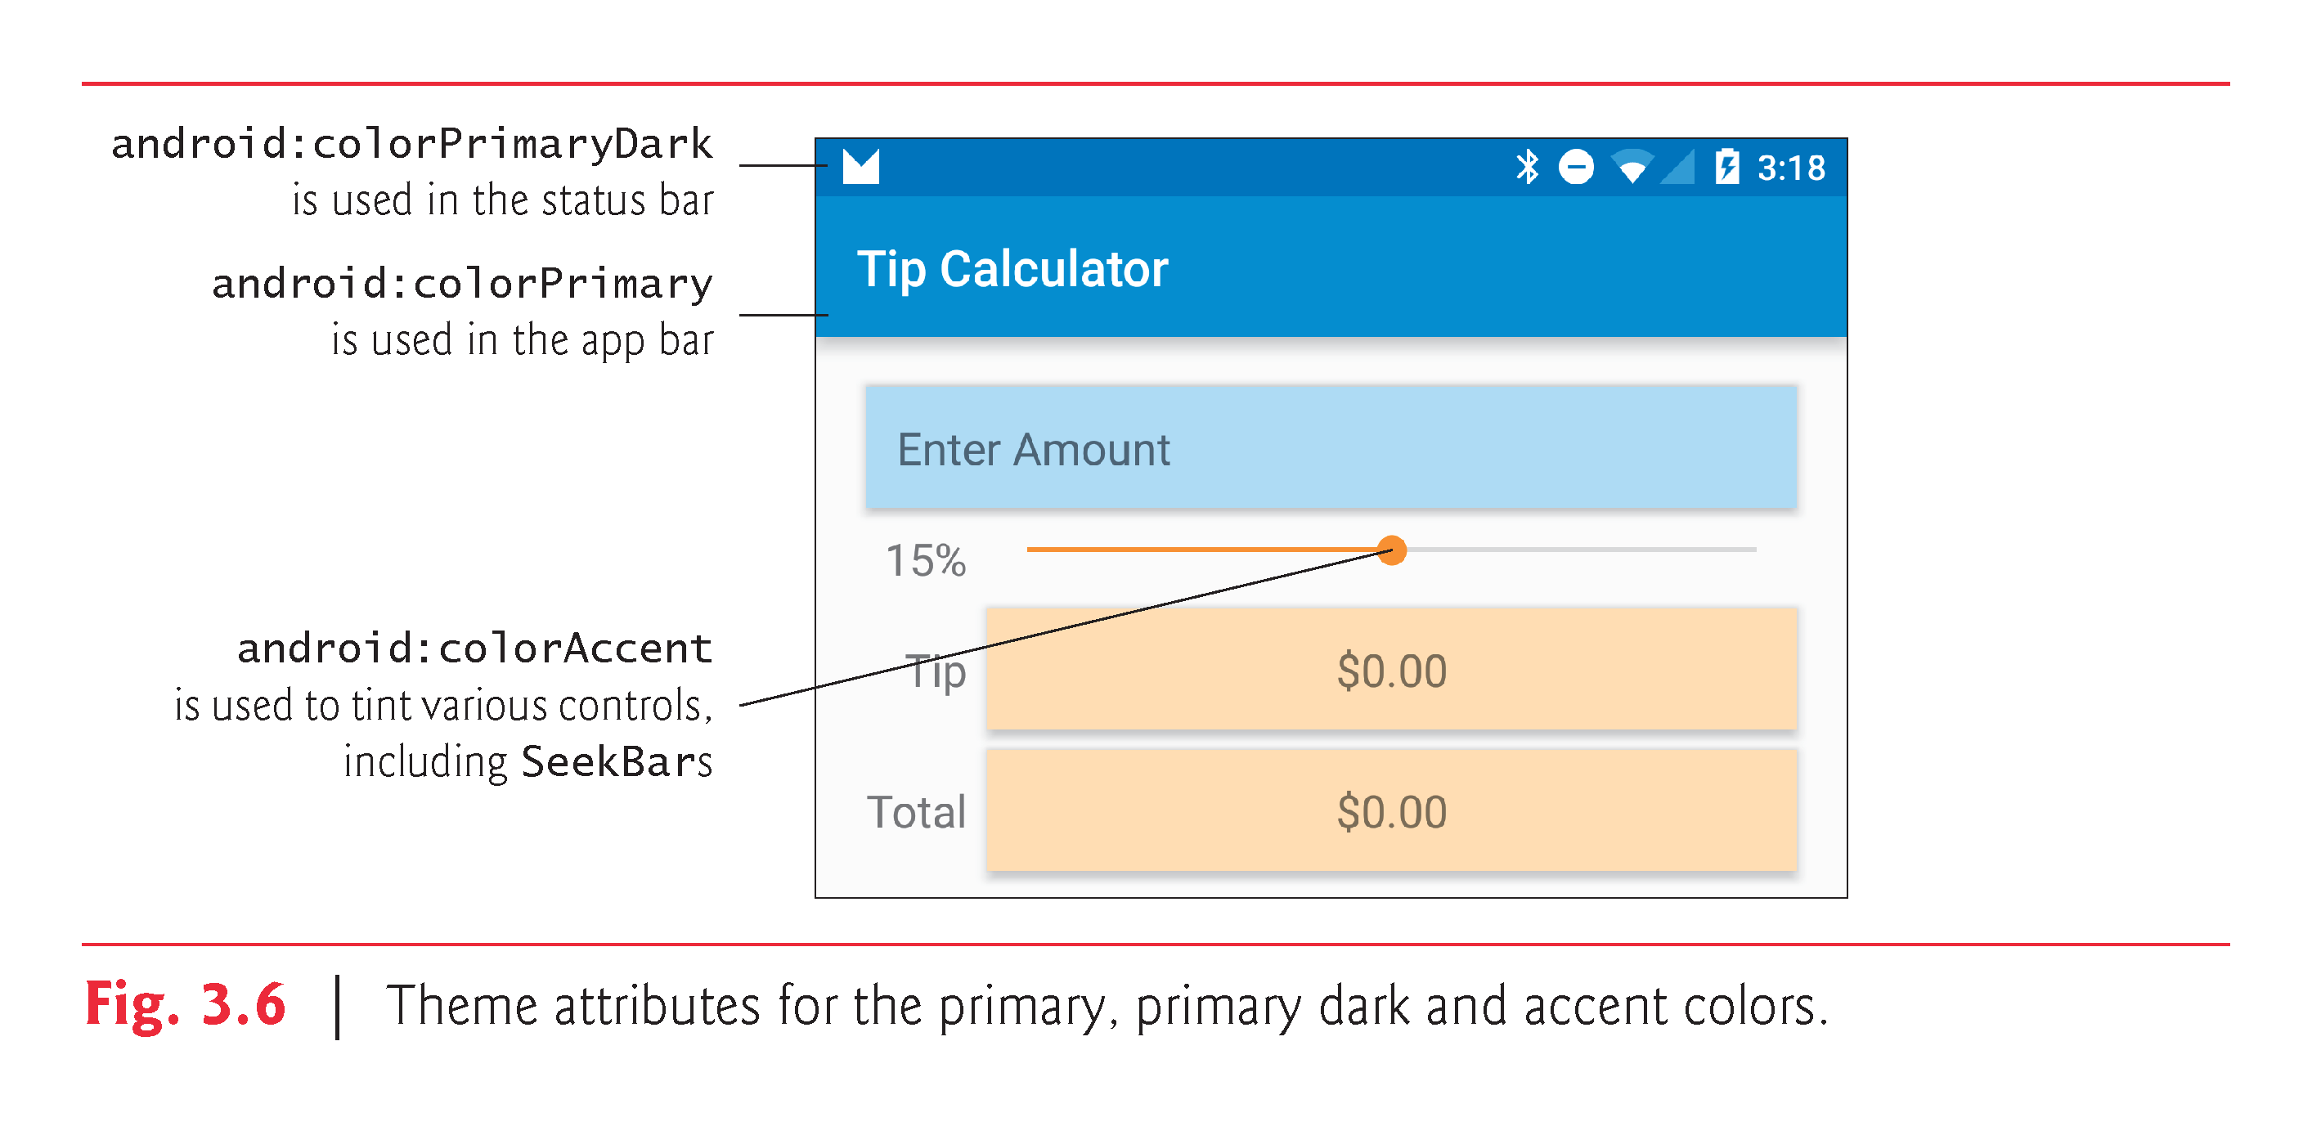

Slide 29
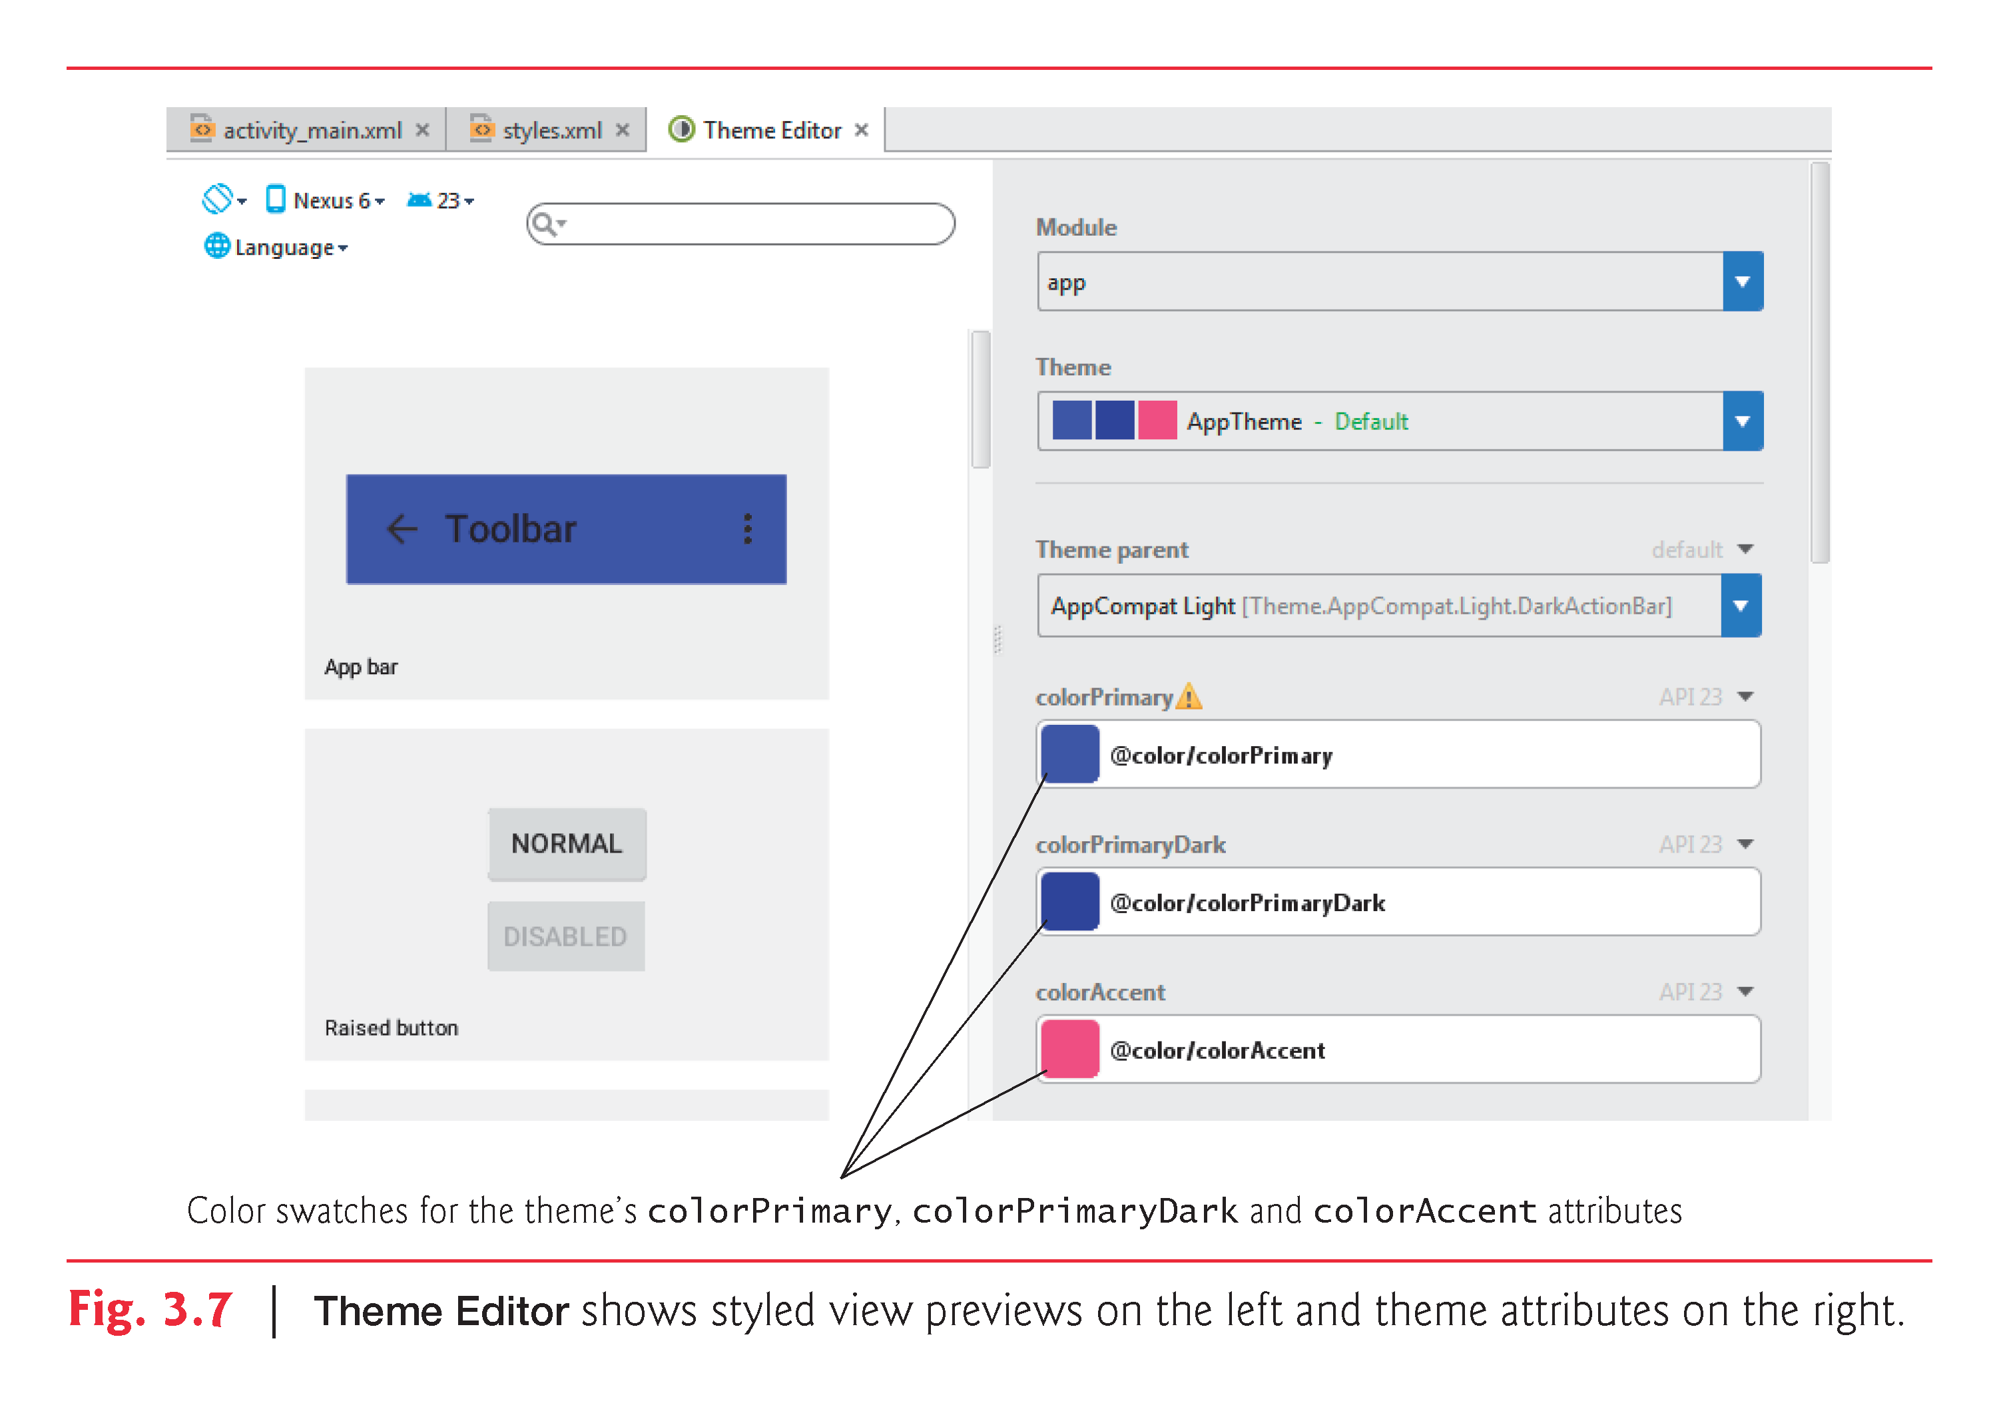

Slide 30
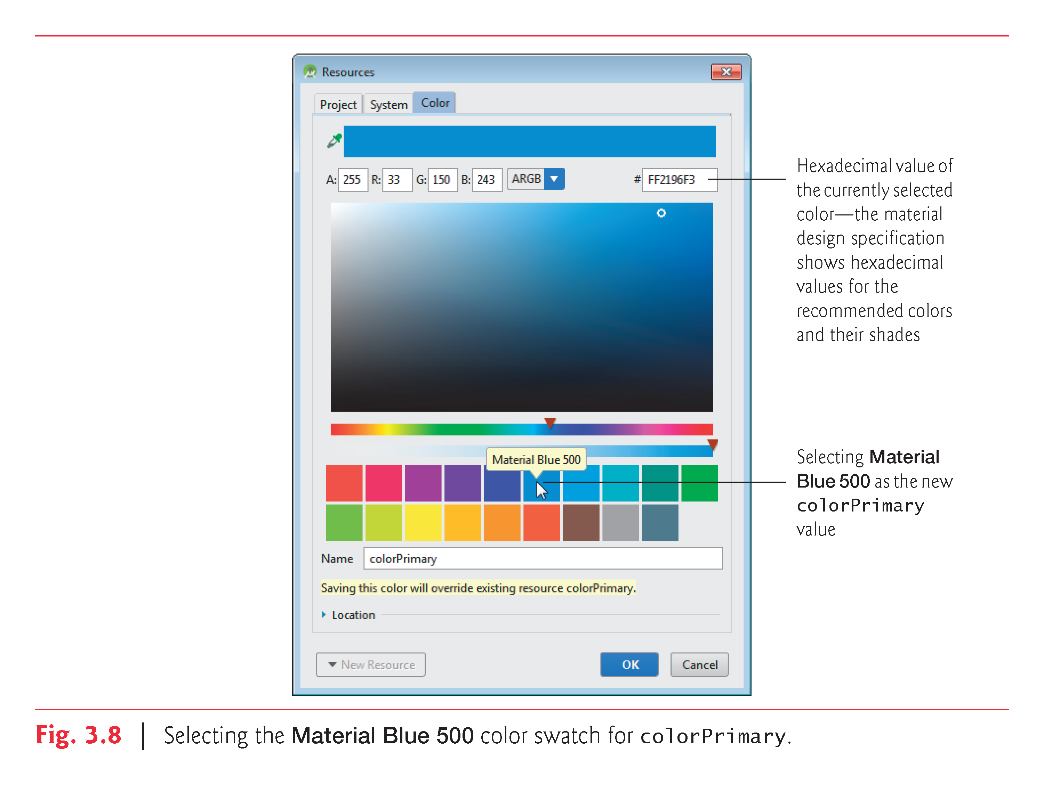

Slide 31
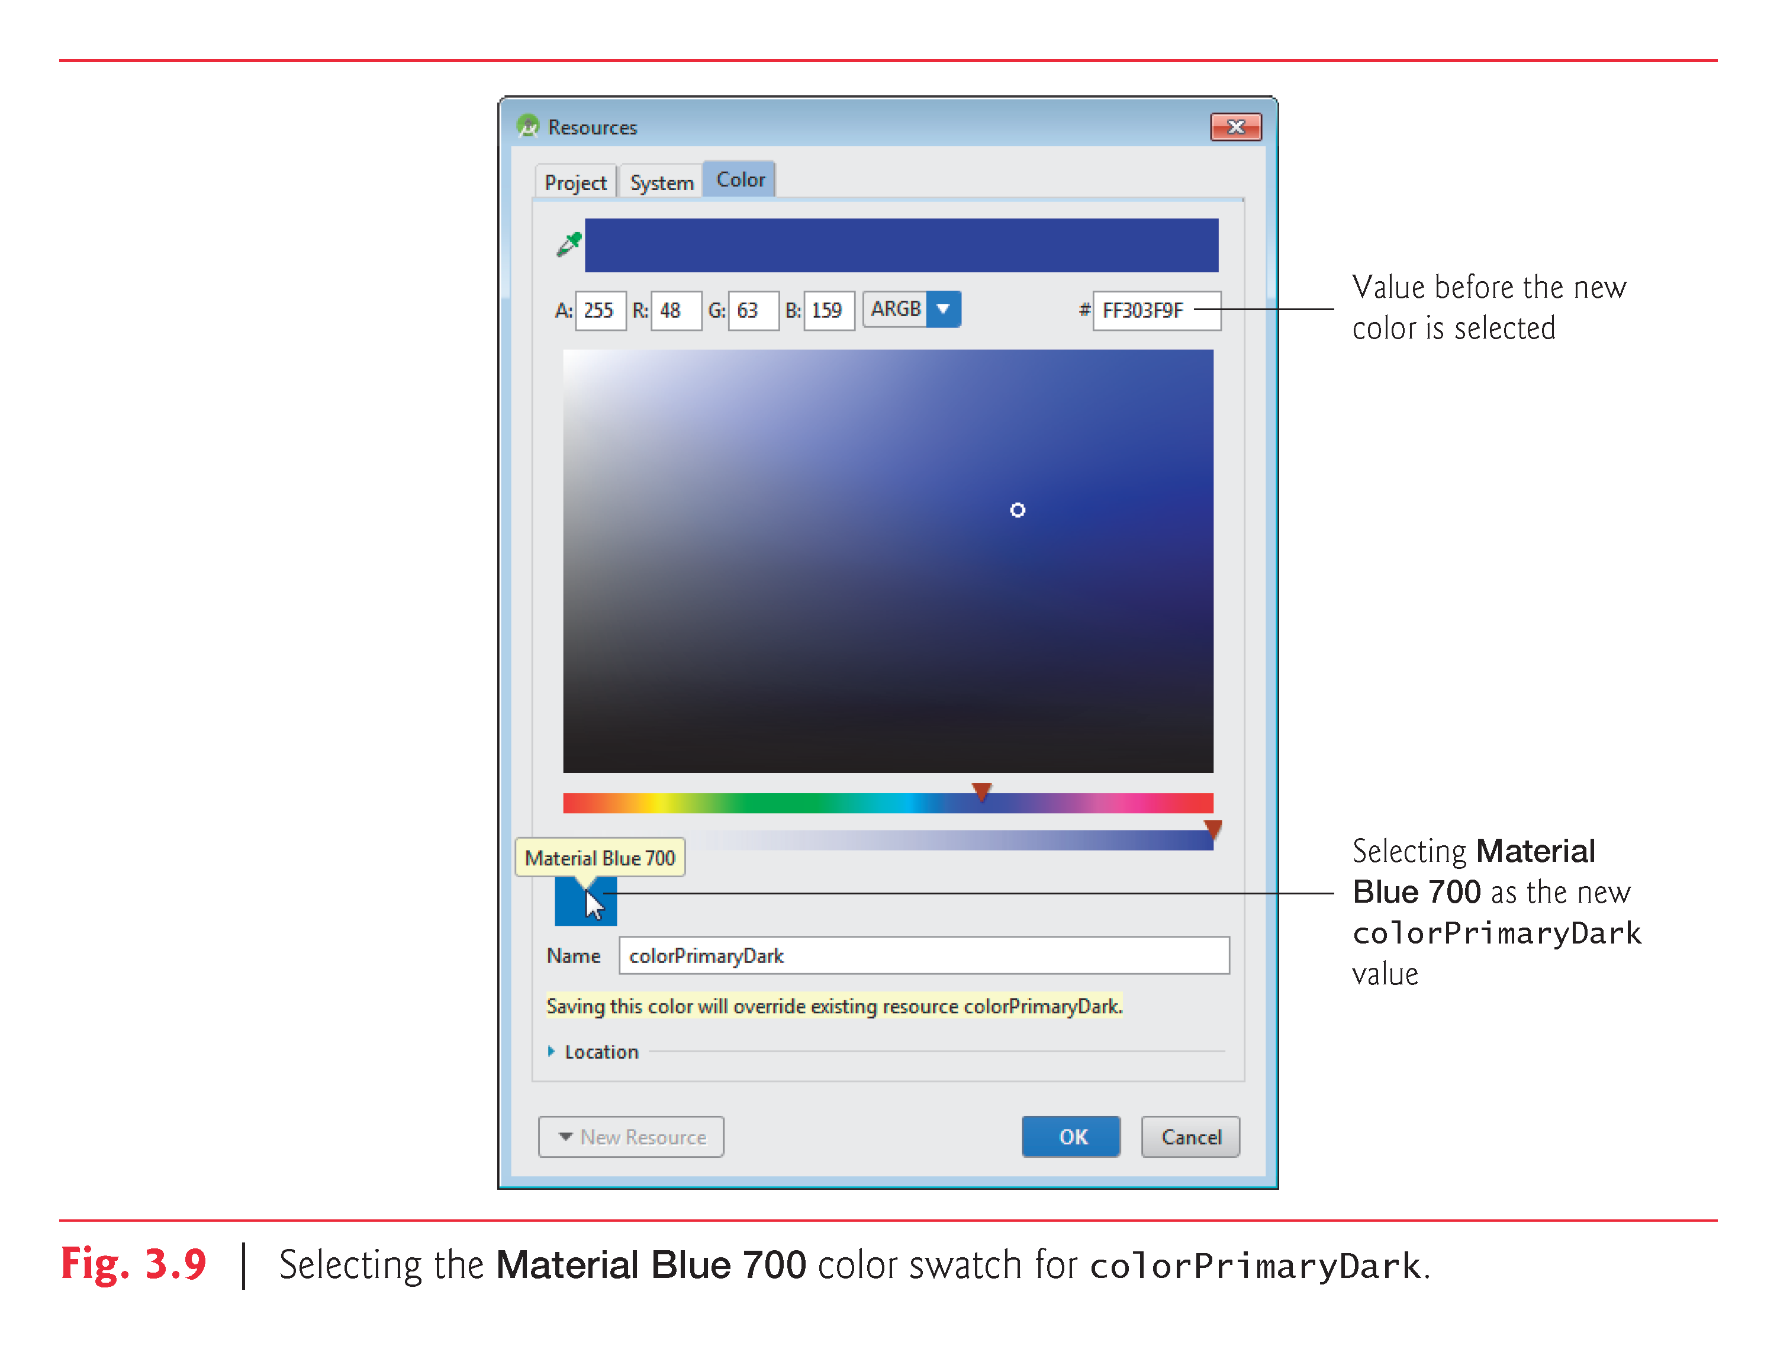

Slide 32
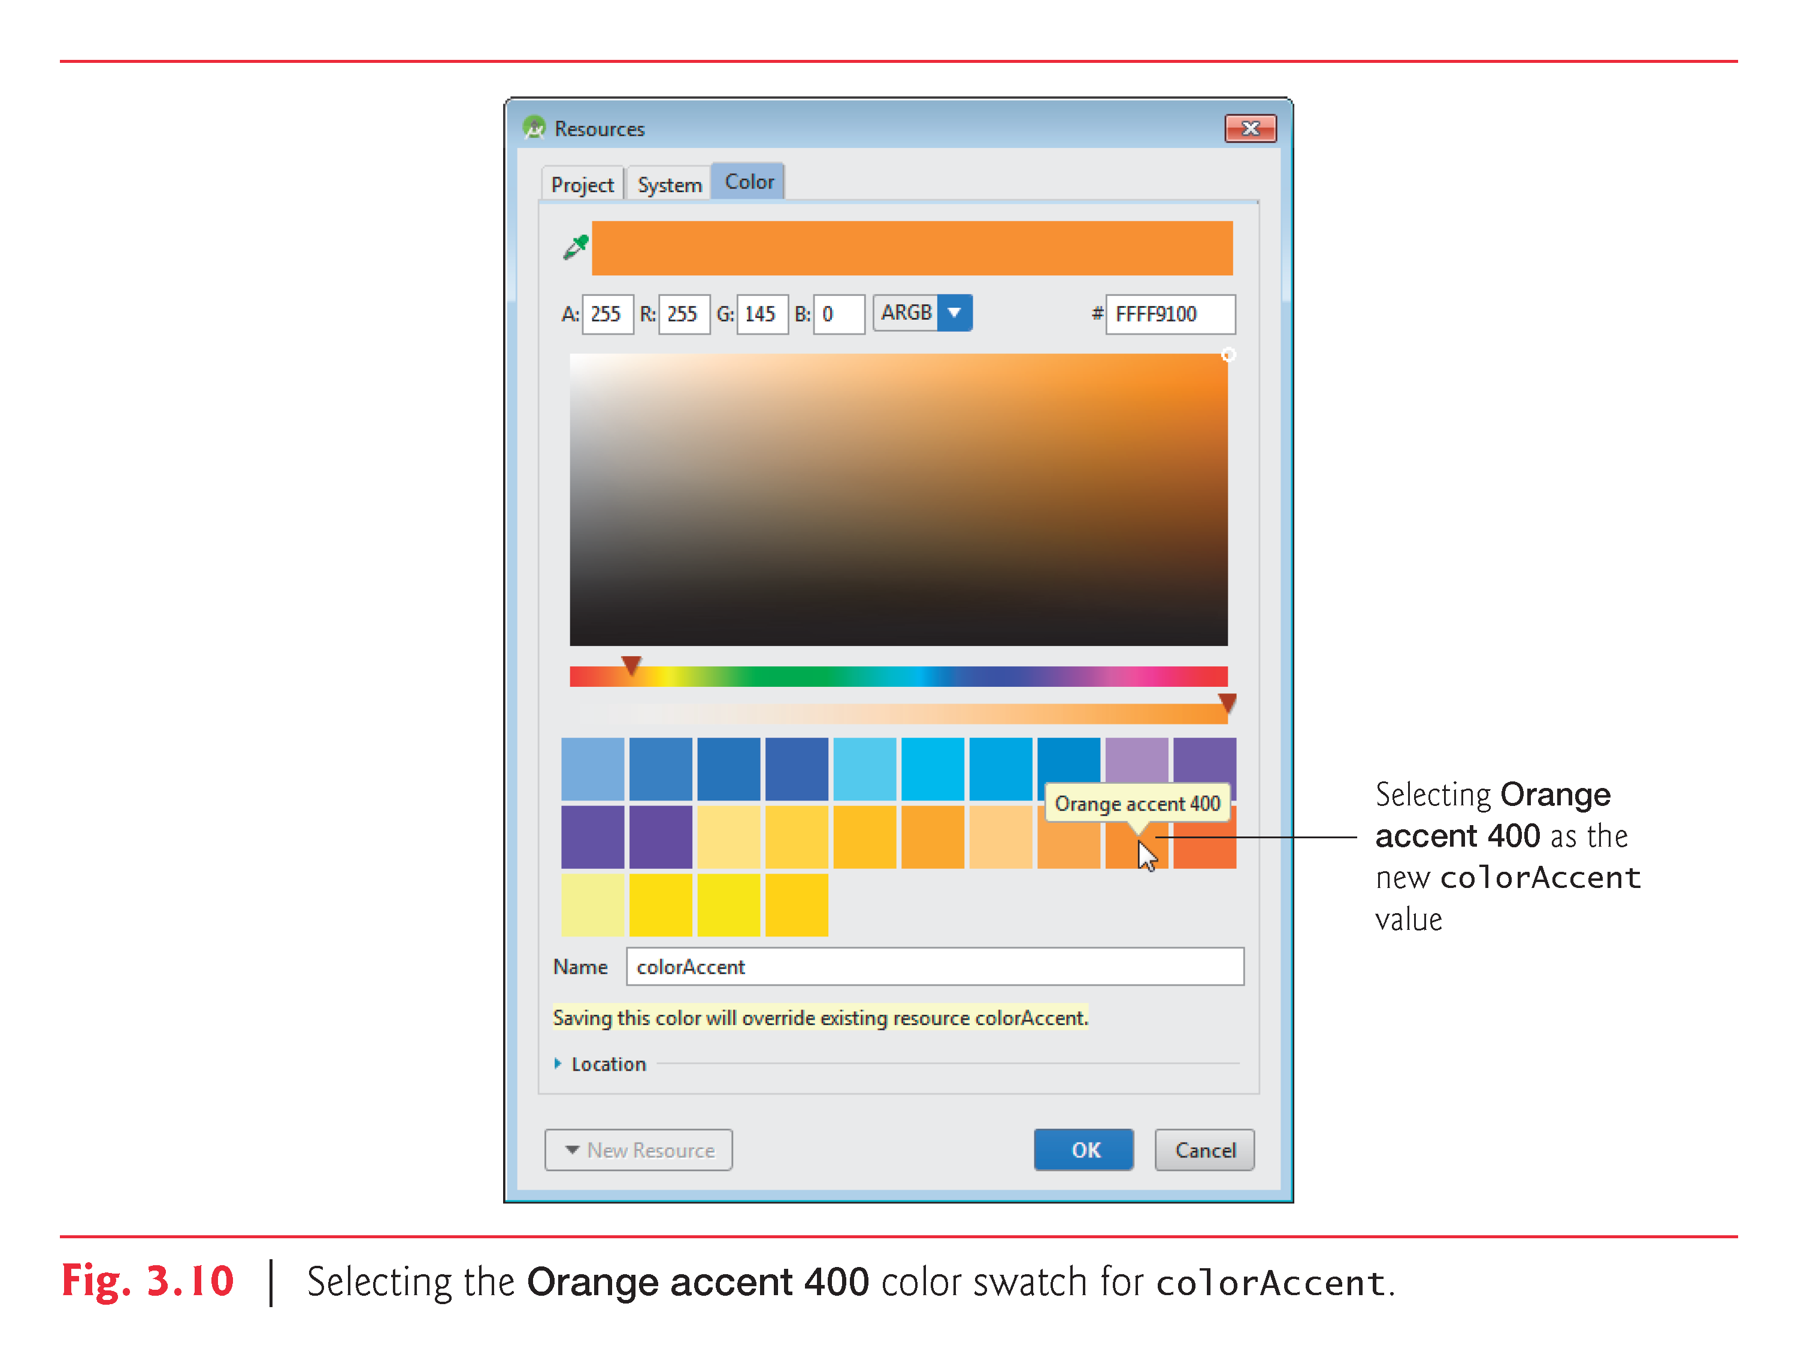

Slide 33
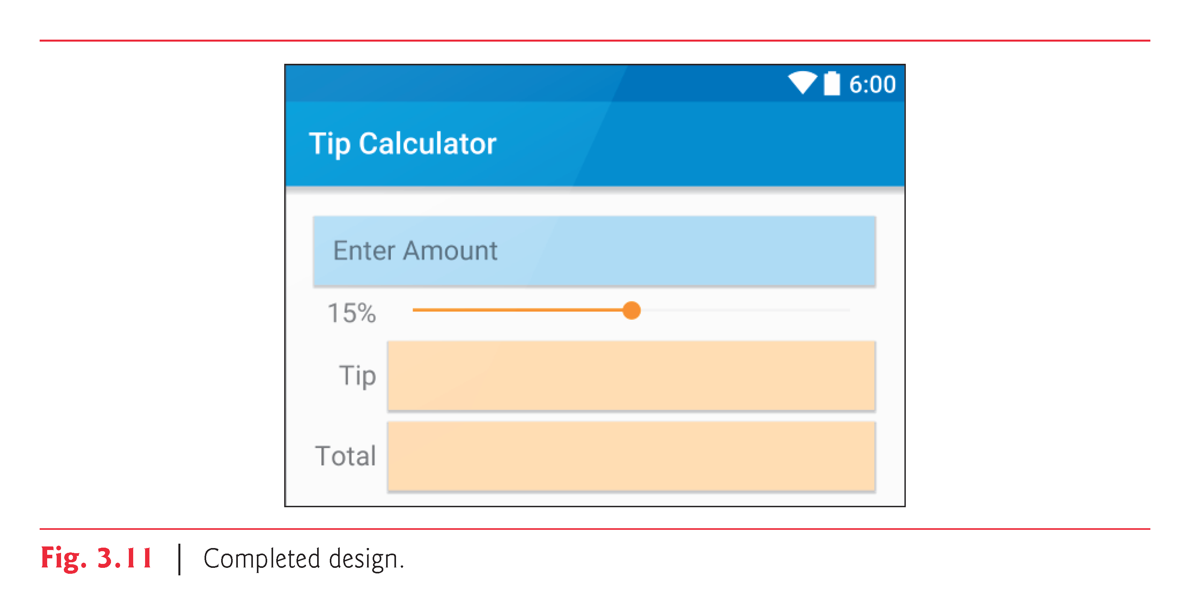

Slide 34
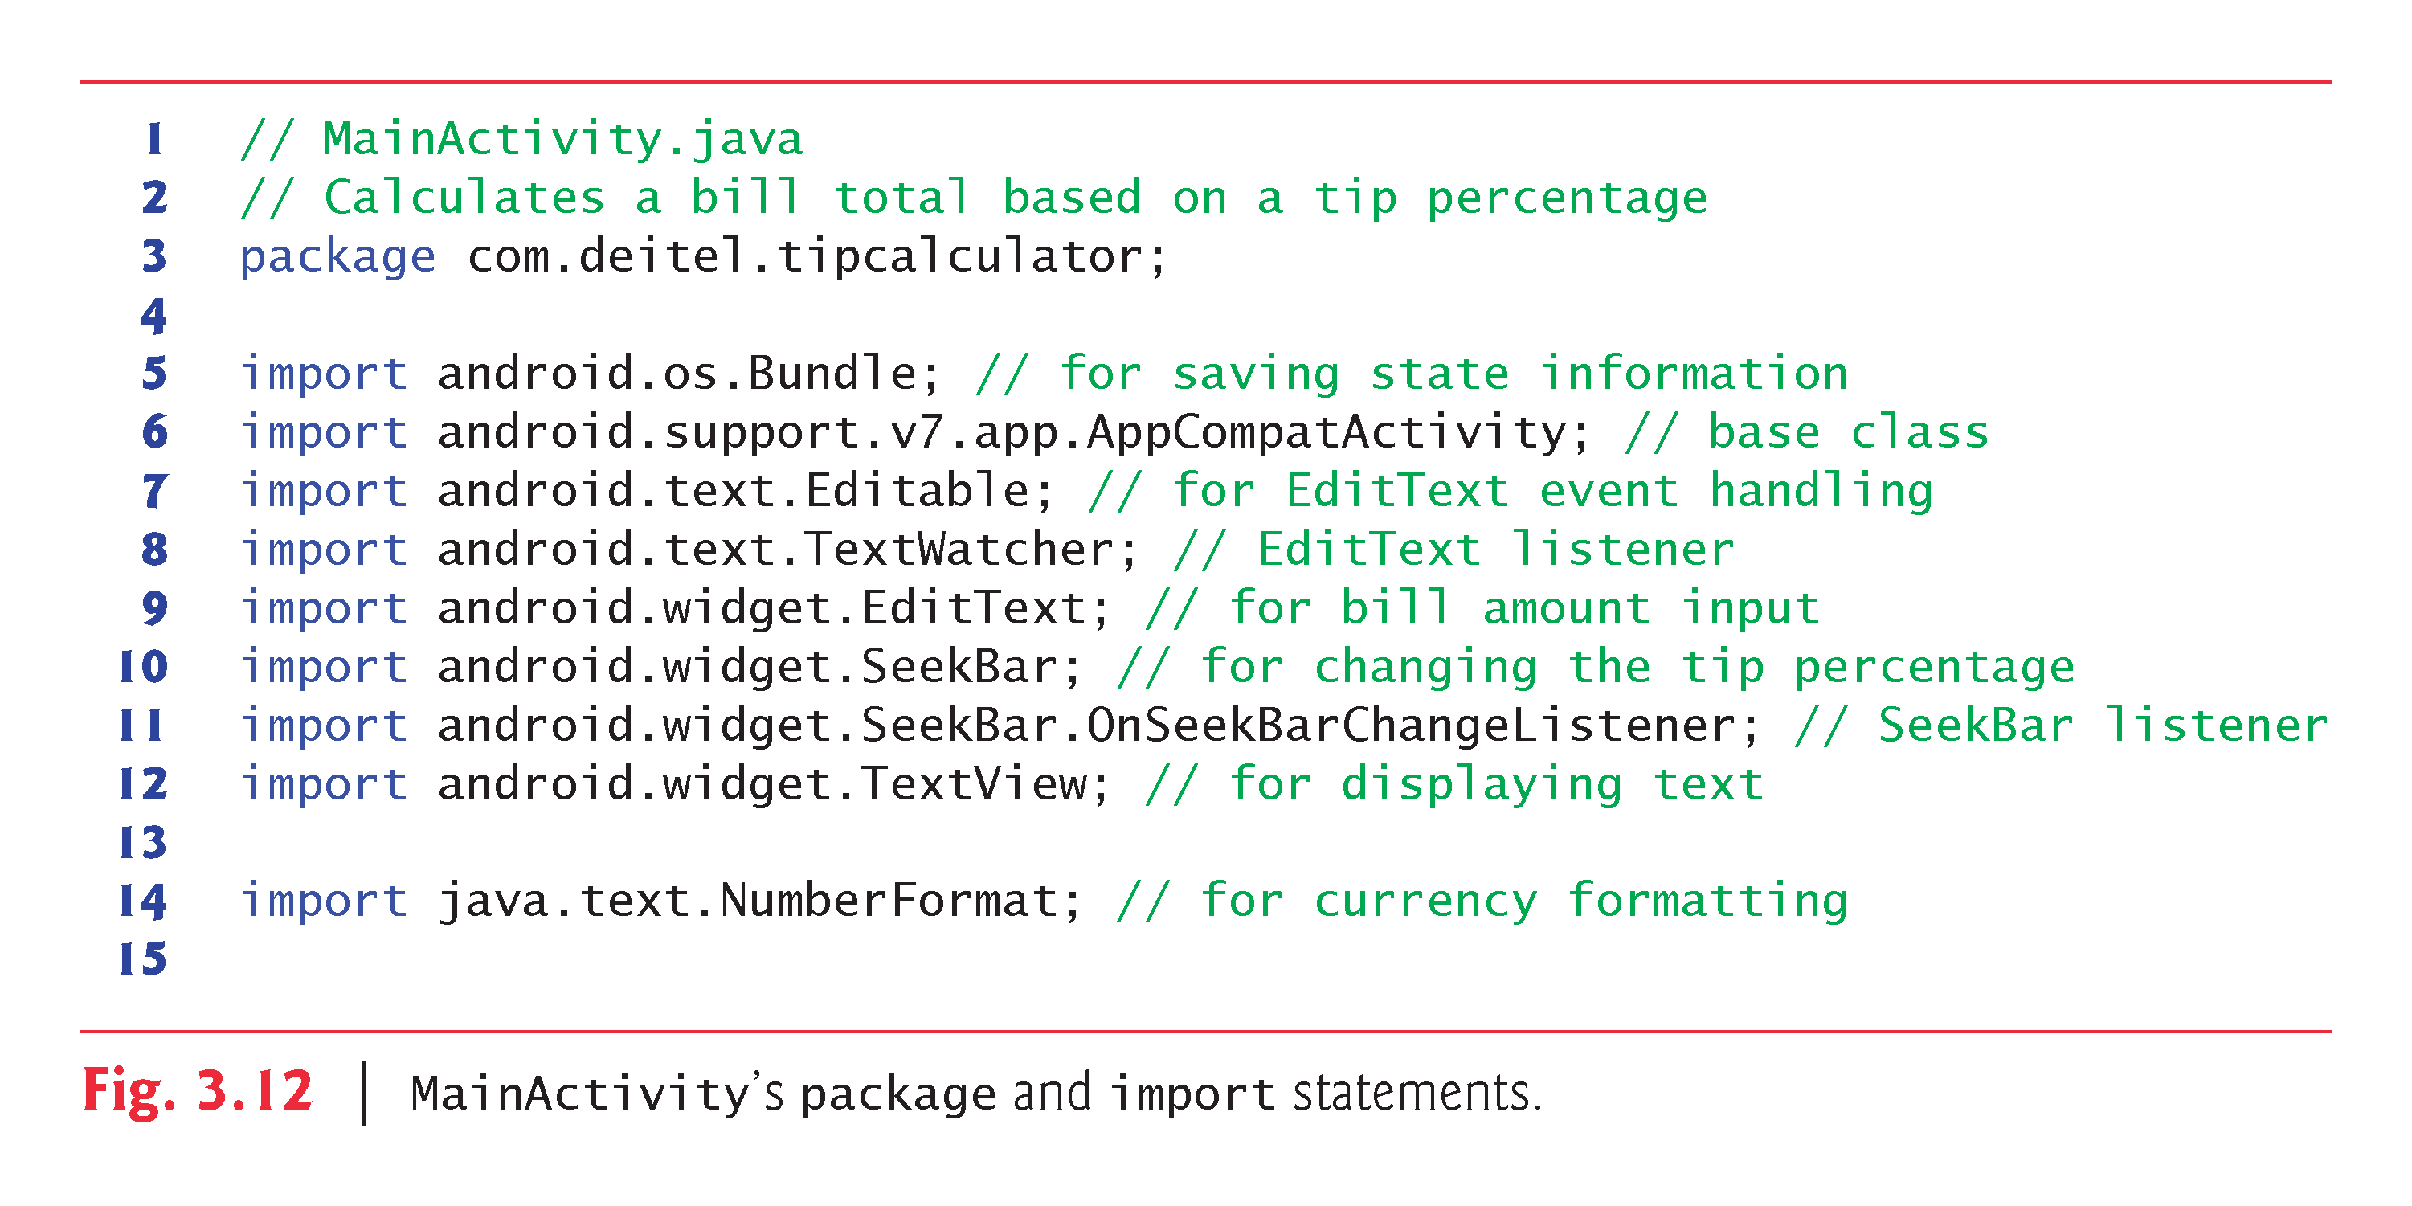

Slide 36
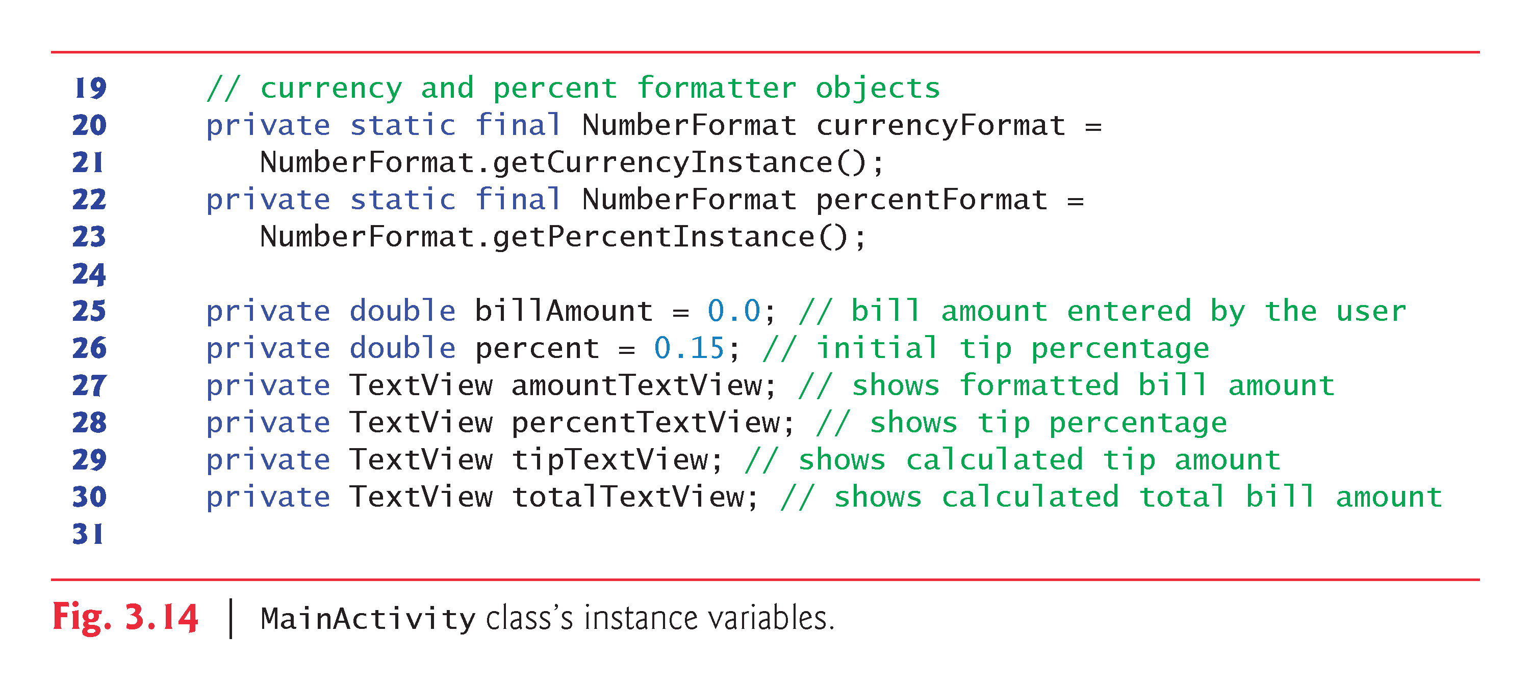

Slide 38
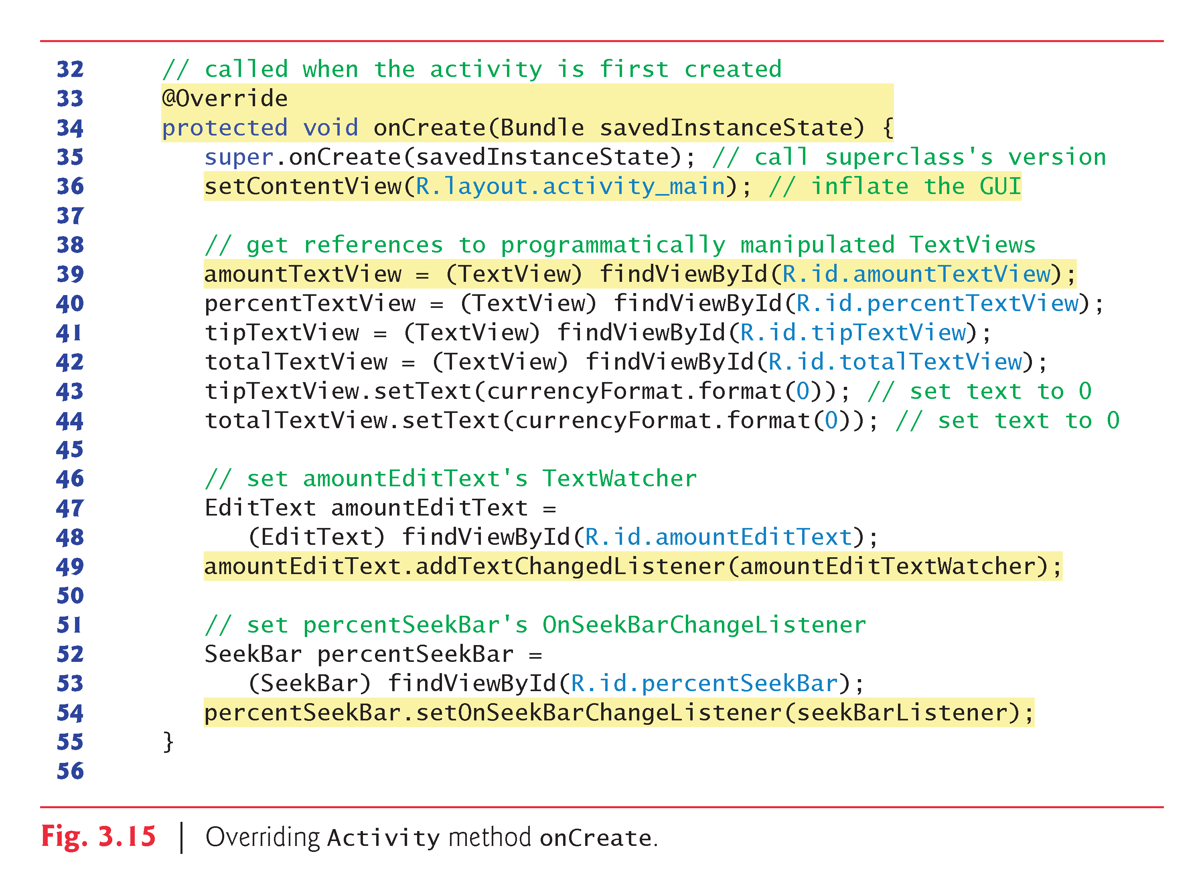

Slide 40
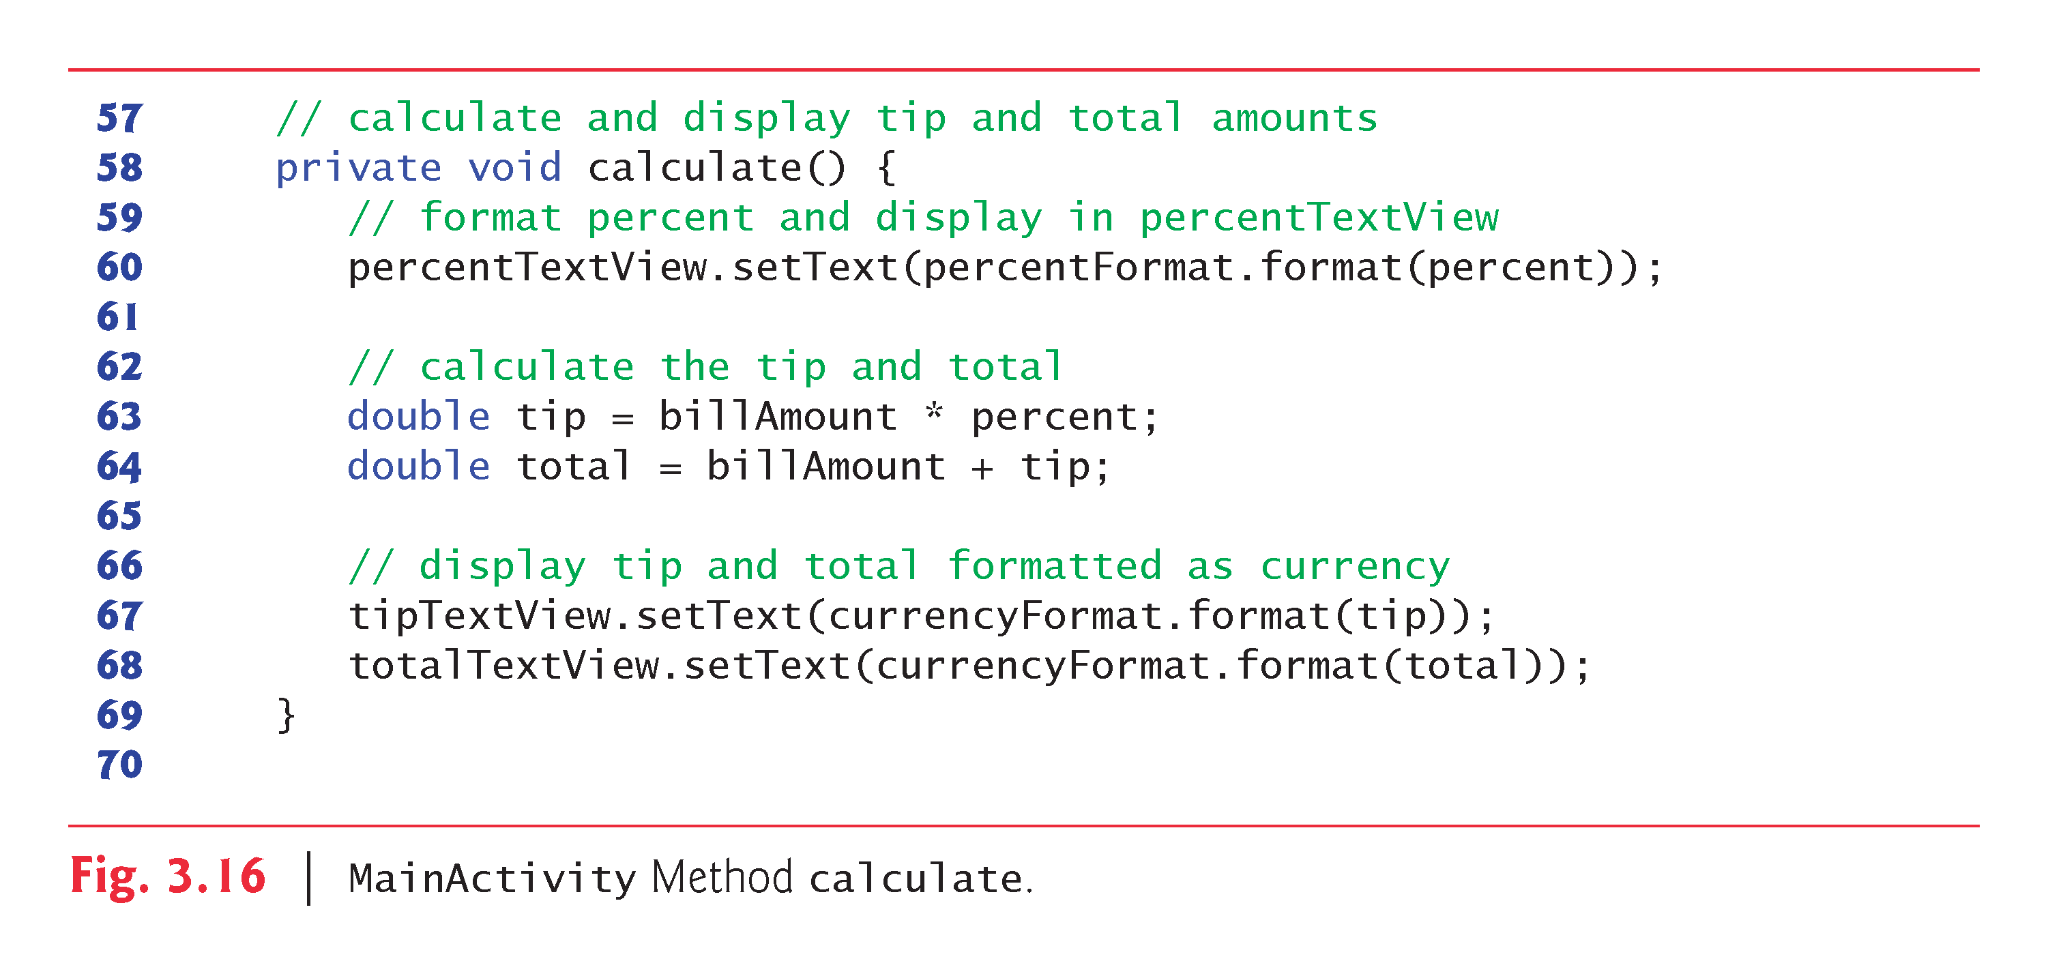

Slide 43
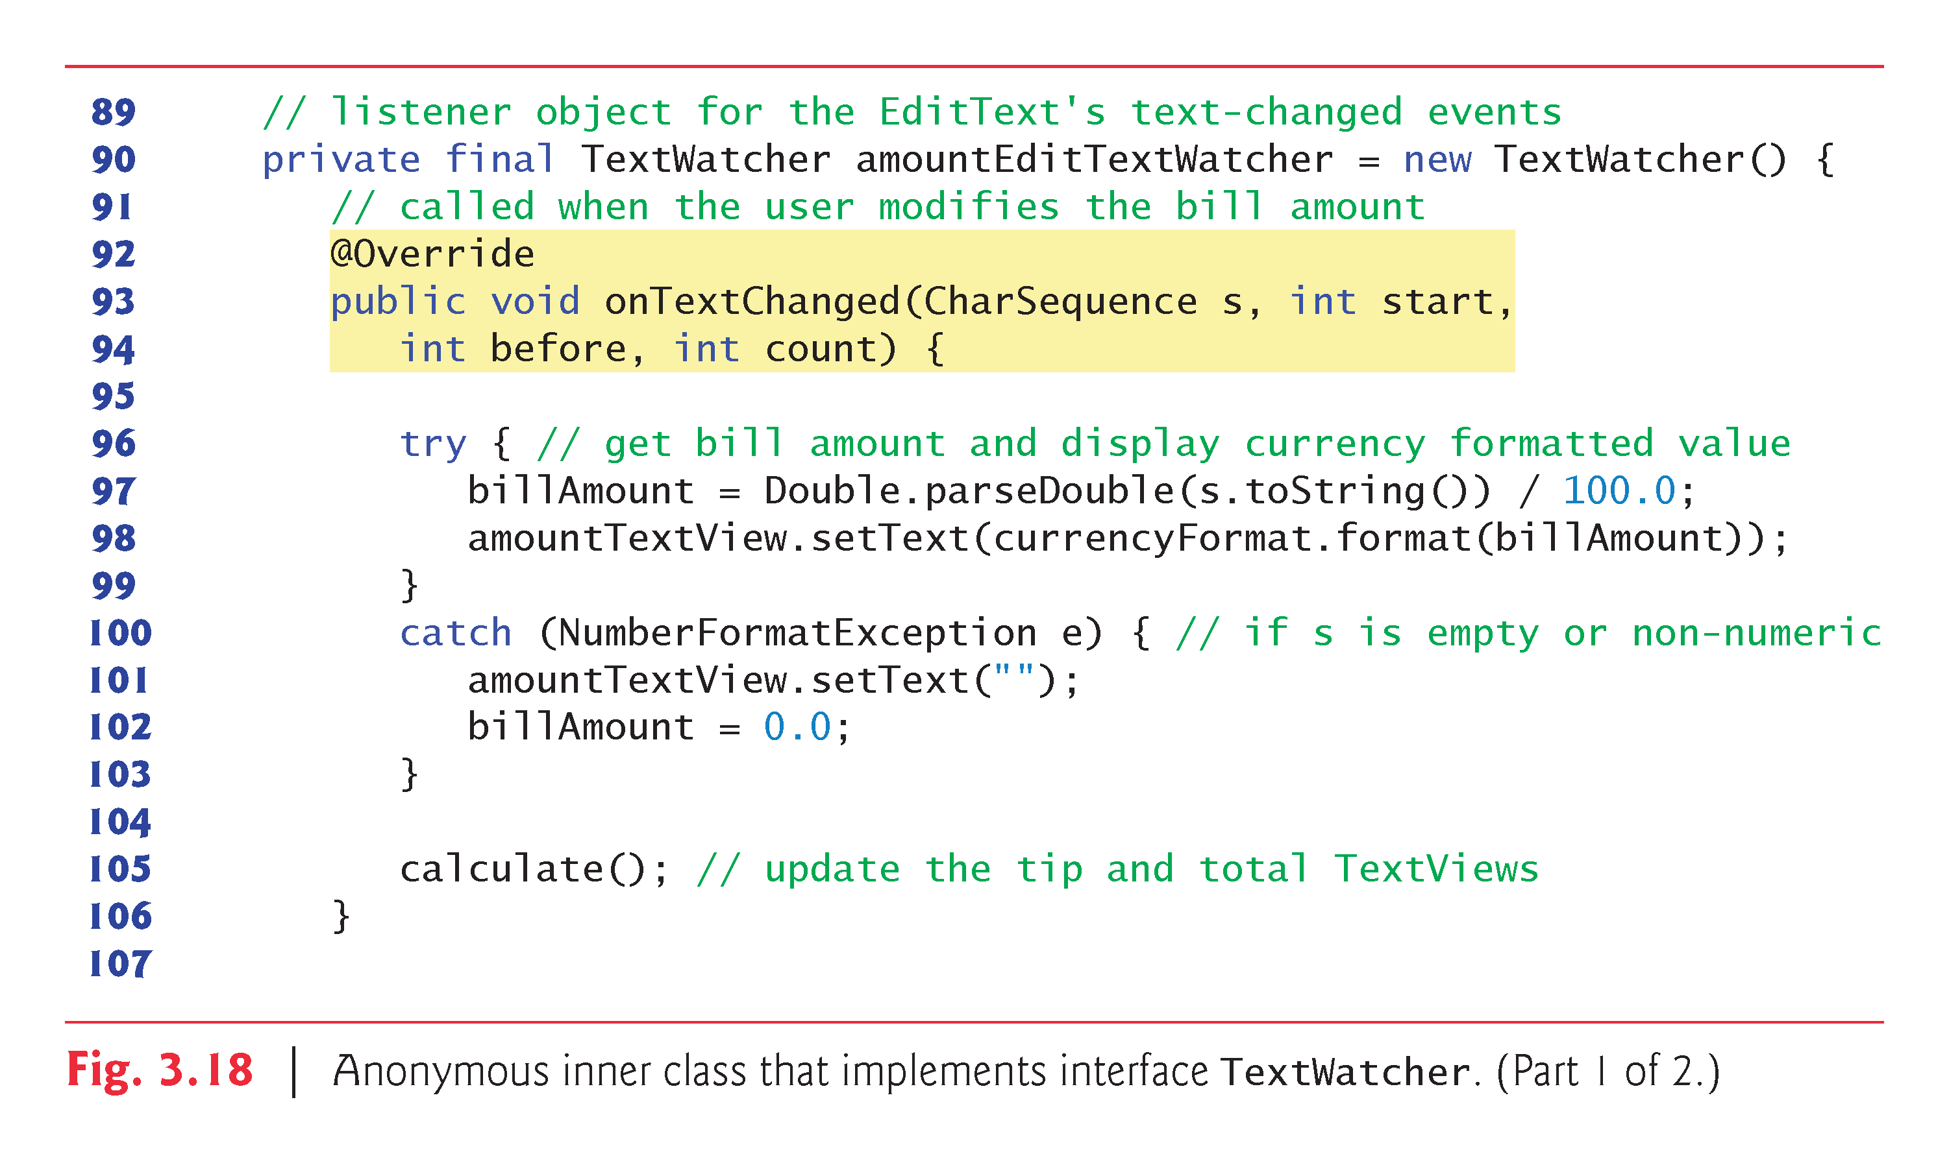

Slide 45
