Slide 1
Fragments: Introduction
Fragments
were introduced in Android 3.0
to support flexible and dynamic UI designs
represent portions of an application’s user interface
Each fragment would contain its own set of views
Have their own life cycle, receiving their own input events
And can be added and removed to an activity at run time
Their lifecycles are affected by the activity creating them
If activity paused => all its associated fragments are paused as well
If activity destroyed => associated fragments are also destroyed

Slide 2
Fragments: Creation
To create a fragment
You must
subclass the Fragment class
and override onCreateView()
The method called to draw the user interface of a fragment
Example:

Slide 3
Adding a Fragment to an activity
A fragment
contributes a portion of the UI to host activity
At any time, one can add fragments to an activity
By using the FragmentTransaction class and
By specifying a ViewGroup in which to place fragment
Example
FragmentManager fragmentManager = getFragmentManager()
FragmentTransaction fragmentTransaction = fragmentManager.beginTransaction();
ExampleFragment fragment = new ExampleFragment();
fragmentTransaction.add(R.id.fragment_container, fragment);
fragmentTransaction.commit();

Slide 4
Fragment Transactions
Fragment transactions
Are performed by means of the
FragmentTransaction class
Each transaction
is a set of changes performed at the same time
And can be reversed by saving it to the back stack
Example:
// Create new fragment and transaction
Fragment newFragment = new ExampleFragment();
FragmentTransaction transaction = getFragmentManager().beginTransaction();
// Replace whatever is in the fragment_container view with this fragment,
// and add the transaction to the back stack
transaction.replace(R.id.fragment_container, newFragment);
transaction.addToBackStack(null);
// Commit the transaction
transaction.commit();

Slide 5
Fragments: Communicating with Activity
A fragment
is independent of an activity
But, can be used inside multiple activities
With a given instance being directly tied to the activity
Containing the fragment
Can access its associated activity using getActivity()
Likewise, an activity can access a fragment
By acquiring a reference to the fragment
via FragmentManager
ExampleFragment fragment = (ExampleFragment) getFragmentManager().findFragmentById(R.id.example_fragment);

Slide 6
Fragments: FragmentManagementApp
Refer to FragmentManagementApp project

Slide 7
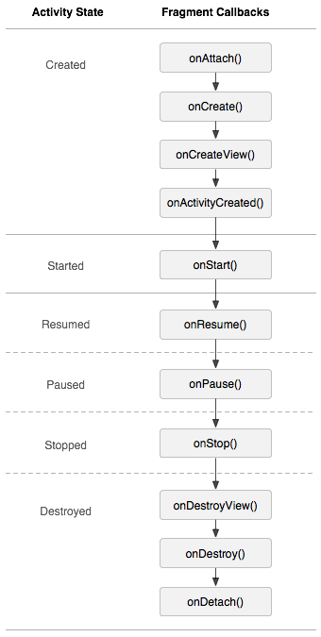
Fragments: Life Cycle
Like activities, fragments
Have their own life cycle
When a fragment
is created
onAttach, onCreate, onCreateView
onActivityCreated
becomes visible
onStart, onResume
goes into background mode
onPause, onStop
is destroyed
onPause, onStop, onDestroyView, onDestroy, on Detach

