Slide 1
Introducing Intents
Intents
  Bind application components and navigate between them
  Transform device into collection of interconnected systems
    Creating a workflow of different screens
  Can be used to either
    Start a new activity explicitly
    Start an activity implicitly
    Broadcast that an event has occured
Notes:
An Android application can contain zero or more activities. When your application has more than one activity, you often need to navigate from one to another. In Android, you navigate between activities through what is known as an intent. So, Intents are used as a message-passing mechanism that works both within your application and between applications. This turns your android device from a platform containing a collection of independent components into a single, interconnected system. One of the most common uses for Intents is to start new Activities, either explicitly (by specifying the class to load) or implicitly (by requesting that an action be performed on a piece of data). In the
latter case the action does not need to be performed by an Activity within the calling application.

Slide 2
Explicitly Starting
New activities
To start a specific activity
The startActivity() method
  Finds and starts the single activity matching your intent
    by explicitly specifying the Activity class to open (see above)
    Or by including an action that the target activity is able to perform
      In which case, an activity is chosen dynamically
      Through a process called intent resolution
Example “UsingExplicitIntent” Android project
Notes:
An android applications consist of a number of interrelated screens — Activities — that must be included in the application manifest. To
transition between them, you will often need to explicitly specify which Activity to open. To select a specific Activity class to start, create a new Intent, specifying the current Activity’s Context and the class of the Activity to launch. Then, pass this Intent into the startActivity method as shown in the code snippet given above. Note that each time you call startActivity, a new Activity will be added to the stack;
pressing back (or calling finish) will remove each of these Activities, in turn. The best way to understand this very important but somewhat abstract concept in Android is to experience it firsthand and see what it helps you achieve.

Slide 3
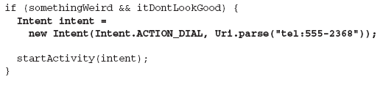

Implicit intents and
Runtime Binding
Implicit intent
  Allows you to ask the system to start an activity
    Without knowing which application will be started
  Constructed by
    Specifying an action to perform and data to act upon
      data can be passed using setData method
Android resolves an intent into an activity class
Notes:
An implicit Intent is a mechanism that lets anonymous application components service action requests. That means you can ask the system to start an Activity to perform an action without knowing which application, or Activity, will be started. You create an implicit intent by passing in an action constant and data. The action portion defines what you want to do, while the data portion contains the data for the target activity to act upon. Android resolves the intent presented in the snippet above and starts an activity that provides the dial action – in this case, the Phone Dialer. When you use an implicit Intent to start an Activity, Android will — at run time — resolve it into the Activity class best suited to performing the required action on the type of data specified. In circumstances where multiple Activities can potentially perform a given action, the user is
presented with a choice.

Slide 4



Native Android Actions
ACTION_VIEW
  Data supplied to be viewed in the most reasonable manner
ACTION_CALL
  Brings up a dialer and immediately initiates a call
  In this case,
    Android.permission.CALL_PHONE should be added to the app
Notes:
Above, I am showing some of the native actions available as a static string constant in the Intent class. When creating implicit intents, you can use these actions. Action_VIEW: Different applications will handle view requests depending on the URI schema of the data supplied. Natively http:
addresses will open in the browser; tel: addresses will open the dialer to call the number; geo: addresses will be displayed in the Google Maps application; and contact content will be displayed in the Contact Manager. In the presented code snippet, the specified address will be opened in the browser. The android.content.Intent.ACTION_VIEW constant actually refers to the “android.intent.action.VIEW” action. With ACTION_DIAL, the user still need to press the dial button. If you want to call number without user intervention, use the ACTION_CALL instead.

Slide 5
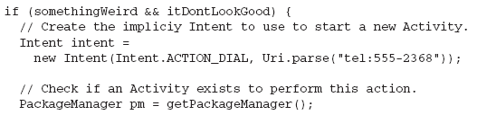
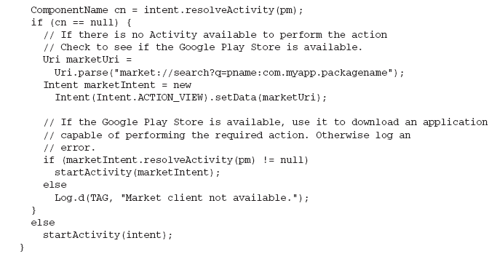
Determining if an Intent will Resolve
It is good practice
  To determine if your call resolves to an Activity
    Before calling startActivity
Notes:
There is no guarantee that any particular application will be installed on a device, or that any application capable of handling your request is available. As a result, it’s good practice to determine if your call will resolve to an Activity before calling startActivity. You can query the Package Manager to determine which, if any, Activity will be launched to service a specific Intent by calling resolveActivity on your Intent object, passing in the Package Manager, as shown above. If no Activity is found, you can choose to direct users to the appropriate application in the Google Play Store. Note that Google Play is not available on all devices, nor the emulator, so it’s good practice to check for that as well.

Slide 6
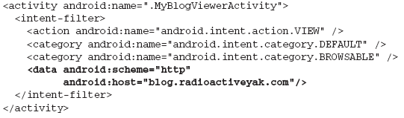
Using Intent Filters to Service Implicit Intents
How does Android know
  Which app to use to service a request?
    Using intent filters, apps can declare actions and data they support
    So, add an intent-filter tag to the manifest node with tags:
      action: android:name specifies the name of action
      category: android:name condition to service the action
      data: which data types you can act on
Notes:
To register an activity as a potential Intent handler add an intent-filter tag using one of the above listed tags. The category tag specifies under which circumstances the requested action will be serviced. The “DEFAULT” category should be applied to an activity that is callable by others using the startActivity() method. If you want your application to respond to actions triggered within the browser, you must include the “BROWSABLE” category. The data tag enables you to specify which data types your component can act on. You may have noticed that clicking a link to a YouTube video or Google Maps location on an Android device prompts you to use YouTube or Google Maps, respectively, rather than the browser. This is achieved by specifying the scheme, host, and path attributes within the data tag of an Intent Filter, as shown above. In this example, any link of the form that begins http://blog.
radioactiveyak.com can be serviced by this Activity. Note that you must include the browsable category in order for links clicked within the browser to trigger this behavior.

Slide 7
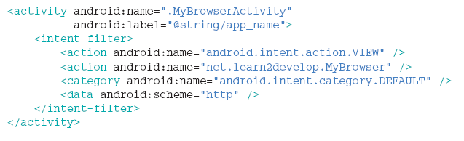
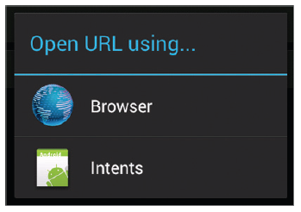

Example: loading URL
Notes:
In the <intent-filter> element, you declared it to have two actions, one category, and one data. This means that all other activities can invoke this activity using either the “android.intent.action.VIEW” or the “net.learn2develop.MyBrowser” action. The <data> element specifies the type of data expected by the activity. In this case, it expects the data to start with the “http://” prefix. You can choose between using the Browser application or the Intents application that you are currently building. You can customize the dialog that appears when multiple activities match your intent as shown in the code snippet above. The code will change the title to “Open URL using…”. The added benefit of this method is that in the event no activity matches your Intent, your app will not crash.

Slide 8
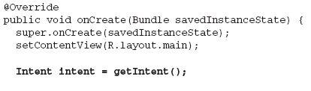

How Android Resolves
Intent Filters
Deciding which activity to start with an implicit intent
  Is called intent resolution
    The aim is find the best filter match possible
      Create a list of all intent filters
      Intent filters not matching action or category are removed
      Any mismatch between URI and data tag => removal
      More than one matches => all possibilities offered to user
To find
  intent used to start activity
Notes:
An Intent Filter will fail the action match check if none of its actions matches the one specified by the Intent. For category matching, Intent Filters must include all the categories defined in the resolving Intent, but can include additional categories not included in the Intent. An Intent Filter with no categories specified matches only Intents with no categories. Each part of the Intent’s data URI is compared to the Intent Filter’s data tag.
Any mismatch will remove the Intent Filter from the list. Specifying no data values in an Intent Filter will result in a match with all Intent data values. When you implicitly start an Activity, if more than one component is resolved from this process, all the matching possibilities are offered to the user. Native Android application components are part of the intent-resolution process in exactly the same way as third-party applications. They do not have a higher priority and can be completely replaced with new Activities that declare Intent Filters that service the same actions.

Slide 9
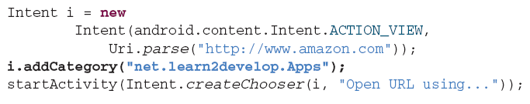
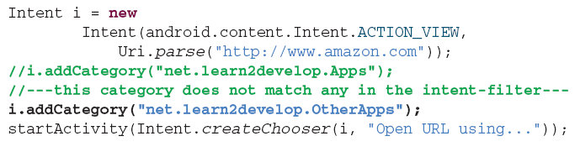
Example: adding categories
Notes:
You add the category to the Intent object using the addCategory() method. If you omit the addCategory() statement, the preceding code will still invoke the MyBrowerActivity activity because it will still match the default category android.intent.category.DEFAULT. However, if you specify a category that does not match the category defined in the intent filter, it will not work (no activity will be launched). The above category (net.learn2develop.OtherApps) does not match any category in the intent filter, so a run-time exception will be raised. when using an Intent object with categories, all categories added to the Intent object must fully match those defined in the intent filter before an activity can be invoked.

Slide 10

Obtaining Data from Another Activity
To call an activity and wait for a result
  startActivityForResult() should be used
In the called activity
  Use an Intent object to send data back via
    setData(), setResult()
In the calling activity
  Override onActivityResult() to handle the returned data
Notes:
The startActivity() method invokes another activity but does not return a result to the current activity. If you need to pass data back from an activity, you should instead use the startActivityForResult() method. An Activity started via startActivity is independent of its parent and will not provide any feedback when it closes. Where feedback is required, you can start an Activity as a sub-Activity that can pass results back
to its parent. When a sub-Activity is finished, it triggers the onActivityResult event handler within the calling Activity. The startActivityForResult method works much like startActivity, but with one important difference. In addition to passing in the explicit or implicit Intent used to determine which Activity to launch, you also pass in a request code. This value will later be used to uniquely identify the sub-Activity that has returned a result. When an activity returns, you need this request code to determine which activity is actually returned.

Slide 11
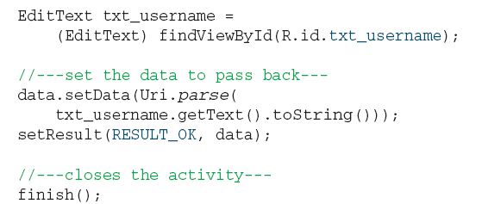
How to Set Data in
Called Activity?
setResult
  Sets a result code
    RESULT_OK or RESULT_CANCELED
finish
  Closes the activity and returns control to calling activity
Notes:
The setResult() method sets a result code (either RESULT_OK or RESULT_CANCELLED) and the data (an Intent object) to be returned back to the calling activity. The finish() method closes the activity and returns control back to the calling activity. In the calling activity, you need to implement the onActivityResult() method, which is called whenever an activity returns. This will be illustrated in the next slide.

Slide 12
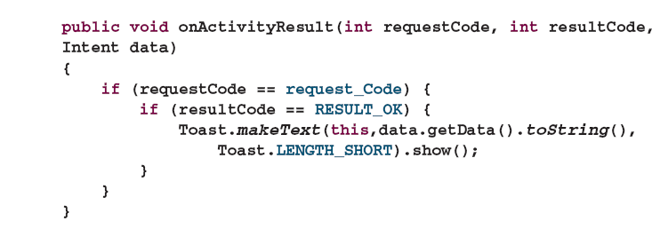
How to Retrieve Data in Calling Activity
requestCode
  The code used to launch the called activity
resultCode
  The result code set by called activity
Data
  Intent received from called activity and encompassing data

Slide 13
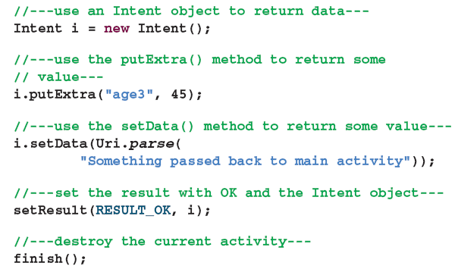
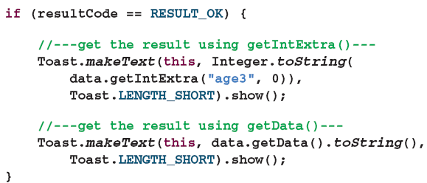
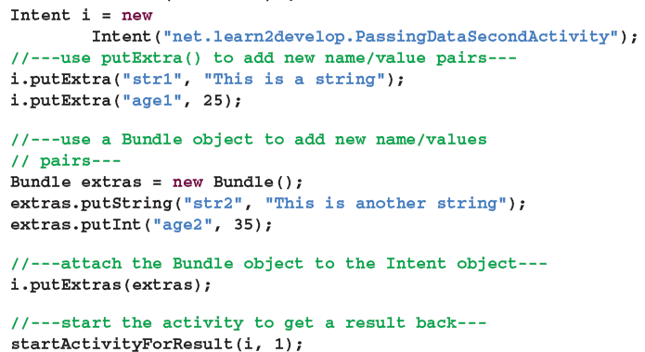
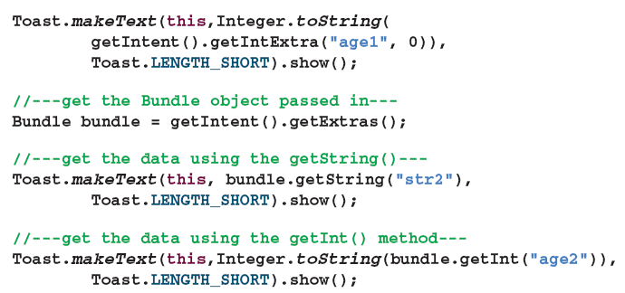
Passing Primitive Data Using the Received Intent Object
Notes:
You can use the putExtra() method of an Intent object to add a name/value pair. Besides using the putExtra() method, you can also create a Bundle object and then attach it using the putExtras() method. Think of a Bundle object as a dictionary object — it contains a set of name/
value pairs. On the second activity, to obtain the data sent using the Intent object, you first obtain the Intent object using the getIntent() method. Then, call its getStringExtra() method to get the string value set using the putExtra() method. For the integer value, use the getIntExtra() method (the second argument is the default value in case no value is stored in the specifi ed name). To retrieve the Bundle object, use the getExtras() method. To get the individual name/value pairs, use the appropriate method. For the string value, use the getString() method. use the getInt() method to retrieve an integer value.

